Slide 1
Use and integration of vocabularies in digital repositories
Imma.Subirats@fao.org
http://aims.fao.org
TaCCIRe Project
Towerbuilding (Norway)
November 15th, 2013

Slide 2
What is aims.fao.org?
Web portal managed by FAO of the UN that disseminates standards and good practices in information and knowledge management for the support of the right to food, sustainable agriculture and rural development
Supports the implementation of structured and linked information by fostering a community of practice centered on the themes of interoperability, reusability and cooperation

Slide 3
What do we do?
To help to make agricultural information increasingly accessible
To promote good practices widely applicable and easy to implement
To adopt, create and publicize standards, tools and services enabling stakeholders to build open and interoperable information systems

Slide 4
Aid to Semantic Navigation and Visibility
Use of Controlled Vocabularies

Slide 5
What is a controlled vocabulary?
List of terms (e.g. words, phrases) that is used to tag (label) information in a consistent way
There are different types of vocabularies like
authority files, classification systems, controlled lists, ontologies, taxonomies, glossaries, subject headings etc.
Objective is to facilitate the retrieval of content

Slide 6
Uses: indexing
Subject vocabularies (words or phrases taken from standardized, organised knowledge structures) should be employed to resolve indexing problems such as plurals, spelling variants, synonyms, homographs (words with same spelling but different meaning), and polysemes (words with multiple meanings) by ensuring that each concept is described using only one authorized term and each authorized term in the controlled vocabulary describes only one concept.

Slide 7
Uses: enhancing access
The use of subject vocabularies guarantees meaningful metadata while also enhancing the quality of the interoperability and effectiveness of information exchange among data providers, thus facilitating the re-usage of data by other repositories/services and in the process adding value to the local researcher.

Slide 8
AGROVOC
A controlled vocabulary in the agricultural field

Slide 9
AGROVOC
Controlled vocabulary covering all areas of interest to FAO, including food, nutrition, agriculture, fisheries, forestry, environment etc.
Contains over 32,000 concepts organized in a hierarchy, each concept may have labels in up to 22 languages

Slide 10
Uses
Standardizes the indexing process in order to make searching simpler and more efficient and to guide the user to the most relevant sources
Used worldwide (researchers, information management specialists) for indexing, retrieving and organizing data in agricultural information systems

Slide 11
Concept Scheme
Developed in the early 80s, as a thesaurus to support uniform indexing of the AGRIS bibliographic database, and then of the whole FAO bibliographic catalogue.
Thesaurus expressed as a concept scheme using SKOS
This conversion from a relational database has provided added semantics value to term relationships

Slide 12
Concepts
Meant to represent the meaning of terms
Set of all terms considered to be translation of one another in various languages
Concepts are given dereferenceable URIs (= URL), such as http://aims.fao.org/aos/agrovoc/c_12332 for maize.

Slide 13
Terms
Or labels, are the actual terms used to name things or abstract concepts
For example maize, maïs, 玉米, ข้าวโพด, are all labels for the same concept in English, French, Hindi respectively.

Slide 14
Relations, between concepts or terms
Concepts: Hierarchical relations between concepts correspond to the classical thesaurus relations broader/narrower (BT/NT)
Terms: range of forms that can occur for each term such as spelling variants, singular or plural, for example organization or organisation, cow or cows

Slide 15
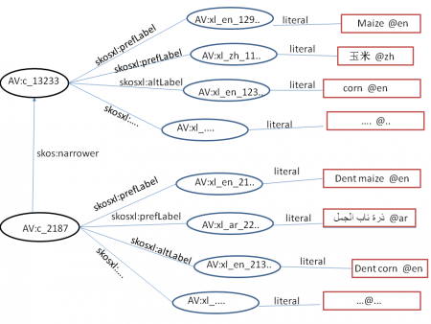
Notes:
The figure below represents a fragment of AGROVOC concept scheme. In that figure, circles are used to represent objects with URIs, boxes are used for literal values, and AV, skos and skosxl are short for http://www.aims.fao.org/agrovoc/“http://www.w3c.org/2008/05/skos-xl#” http://www.w3c.org/2004/02/skos/core#” respectively.
The figure shows two concepts linked by a (hierarchical) skos:broader relation, and an example of SKOS-XL labels for each concept.
All domain-specific properties used in AGROVOC to enriching the description of AGROVOC concepts in RDF are collected in a vocabulary called agrontology. Agrontology is undergoing a deep analysis in order to make very explicit the modelling style adopted in its various topic areas.

Slide 16
Maintenance
Collaborative effort
AGROVOC is kept up to date by the AGROVOC team in FAO, by a number of involved institutions serving as focal points for specific languages, and by individual domain experts

Slide 17
AGROVOC and Linked Open Data
Towards the Semantic Web

Slide 18
The Semantic Web
The main difference between the web of hypertext and the Semantic Web is that while the first links in html pages or documents, the second calls for going beyond the concept document and link structured data
In this context, Linked Data is the set of best practices for publishing and connecting structured data on the Web
Its main objective is to liberate data from silos that are framed by proprietary database schemas

Slide 19
Four rules
Defined by Tim Berners-Lee in 2006:
to use URIs (uniform resource identifiers) to identify resources uniquely;
to use http URIs so people can access the information about the resource;
to provide information about the resources using standard formats like RDF/XML; and
to include links to other resources, URIs, enhancing the linking between different resources distributed on the web.

Slide 20
What is Linked Open Data?
Linked Open Data (LOD) is Linked Data distributed under an open license that allows its reuse for free.
In 2010, Tim Berners-Lee defined a 5-star rating scheme to encourage data providers to provide linked data under open licenses.
The scheme uses gold stars to evaluate the availability of linked data as linked open data.

Slide 21
How to facilitate the linking between resources?
The easiest way is the use of standard vocabularies, including standard vocabularies for describing data/metadata elements and standard vocabularies for indicating values.

Slide 22
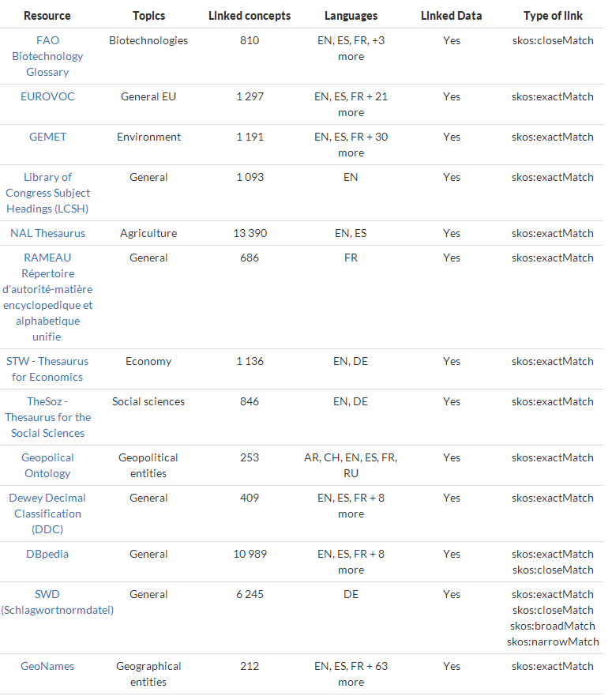
AGROVOC

Slide 23
AGROVOC as Linked Open Data
The additional value that linking AGROVOC to other vocabularies provides is that data repositories attached to those vocabularies become discoverable
This is a very simple classic case of exposing repository contents automatically across datasets through AGROVOC indexing.

Slide 24
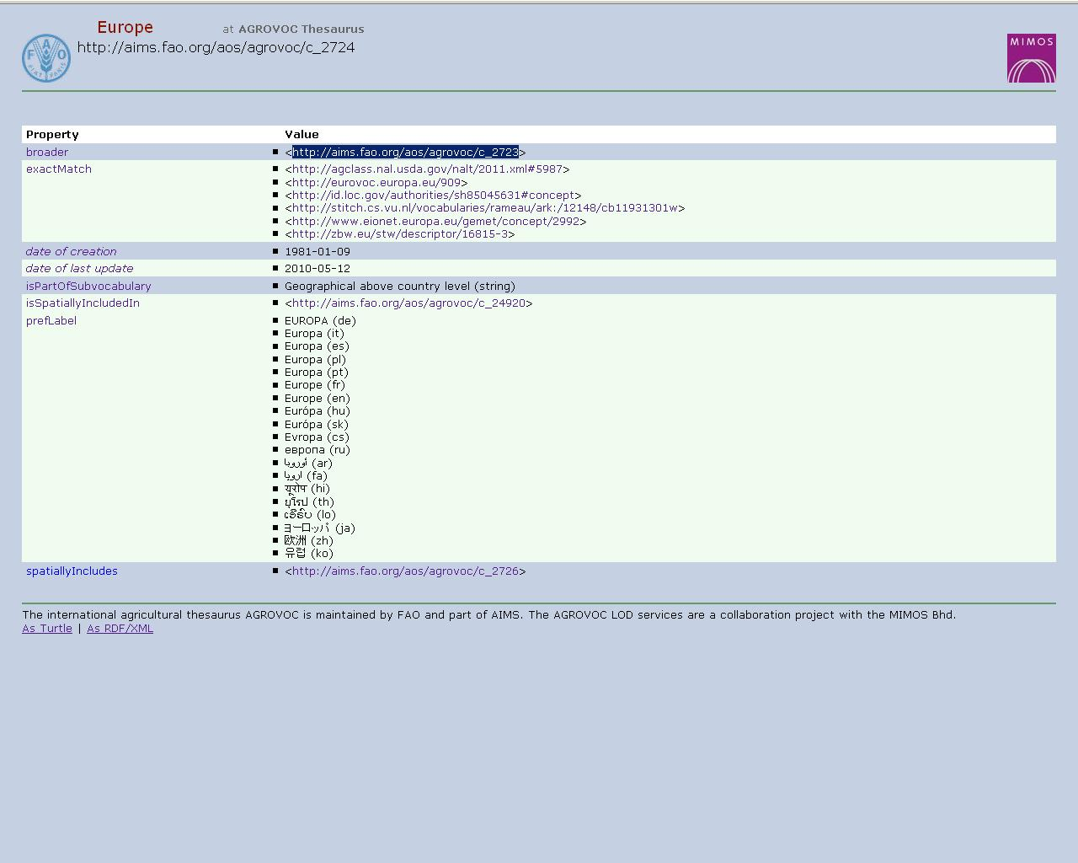
AGROVOC LOD- links
Notes:
Note: we also put the URIs for each relationship so that anybody can use our existing relationships for building the ontology.

Slide 25
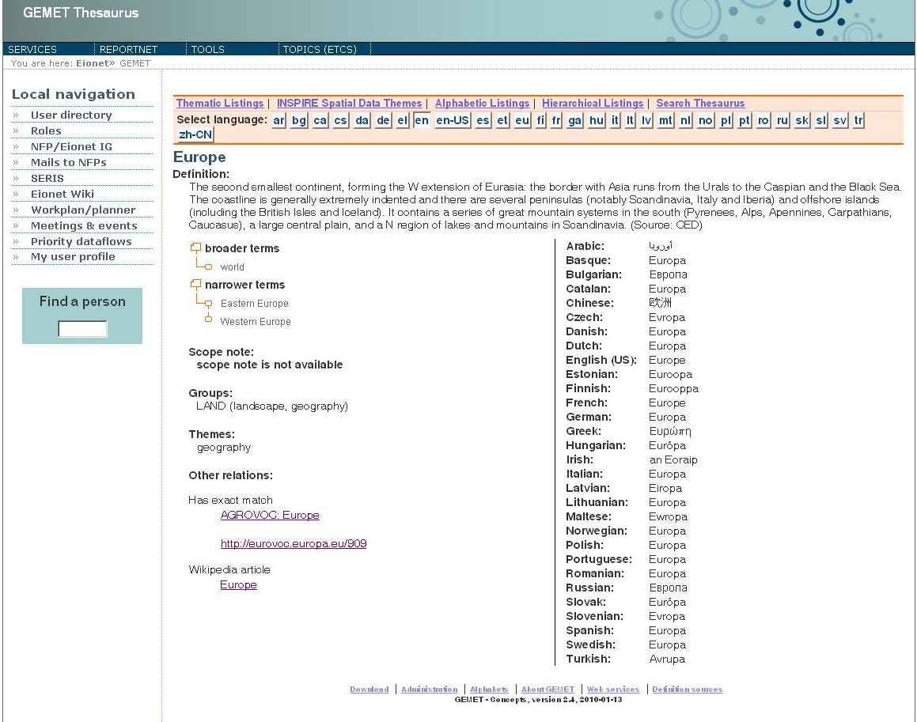
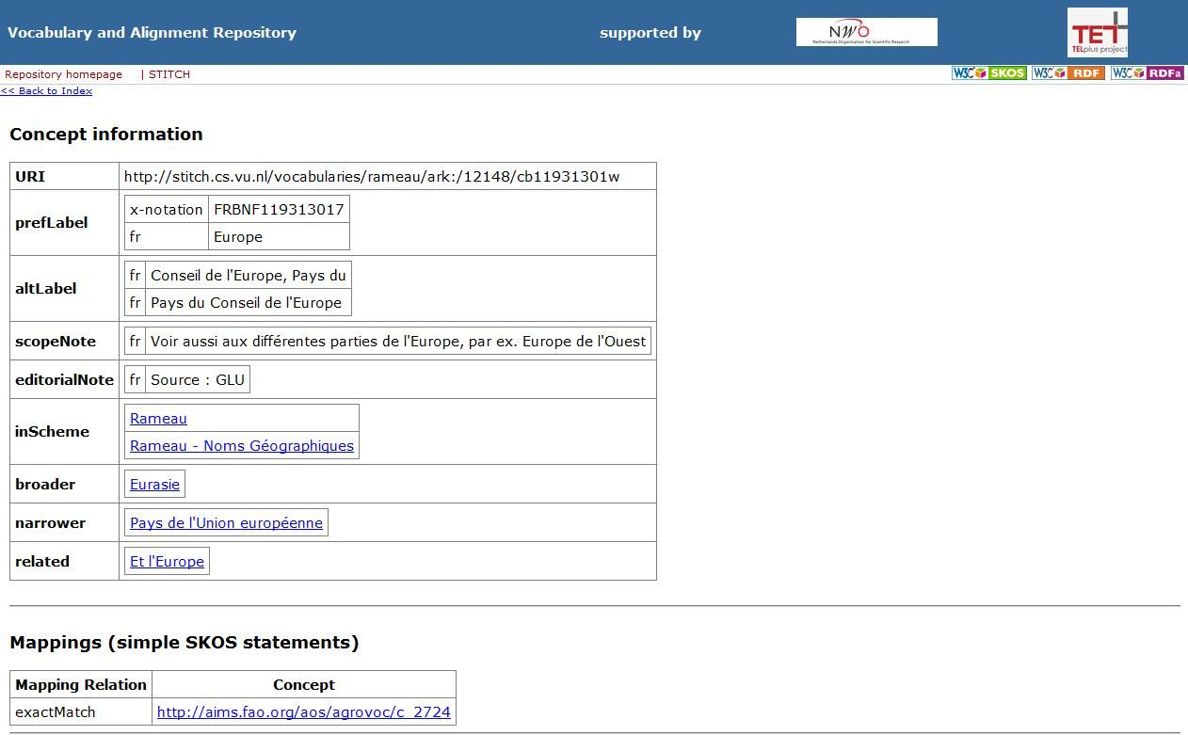
AGROVOC LOD- links
Notes:
- All links are checked by a domain expert.

Slide 26
DSpace and AGROVOC
AgriOcean DSpace and the Ontology Plugin

Slide 27
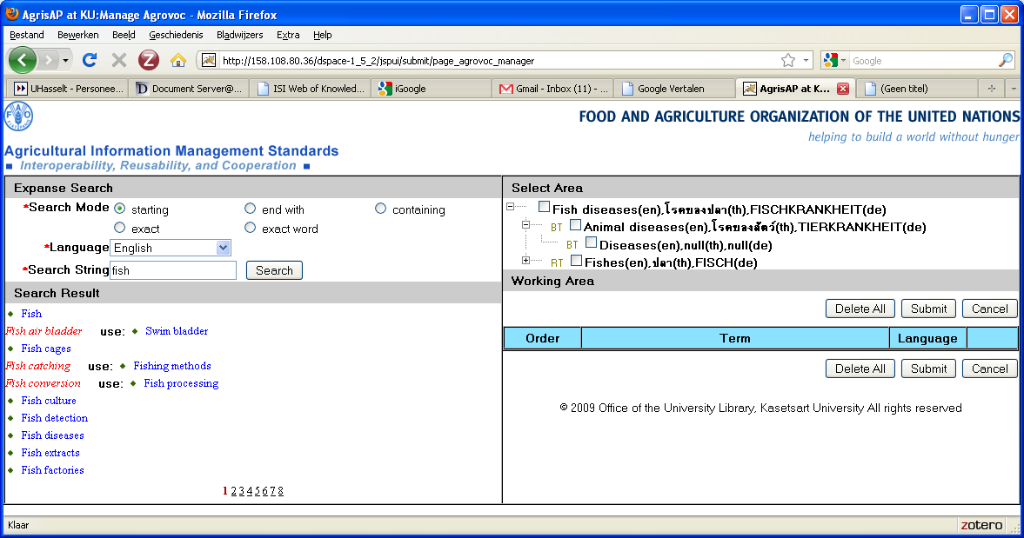
Thesaurus plug-in for AGROVOC
Plug-in for Dspace defined by FAO (Feb. 2009)
Authority control of AGROVOC terms during submission in Dspace - Implementation of Semantic Tools
Developed for Dspace 1.4 by Kasetsart University (Bangkok, Thailand)

Slide 28
AgriOcean DSpace
Joint initiative between the United Nations agencies of FAO and UNESCO-IOC to provide a customized version of DSpace using standards and controlled vocabularies in oceanography, marine science, food, agriculture, development, fisheries, forestry, natural resources and related sciences.
The communities supported by FAO and UNESCO-IOC/IODE are synergistic and the standards on metadata and controlled vocabularies are similar for both.
Communities: AGRIS – ASFA - ODINS
Standards: Agris AP – MODS
Thesauri: AGROVOC – ASFA

Slide 29
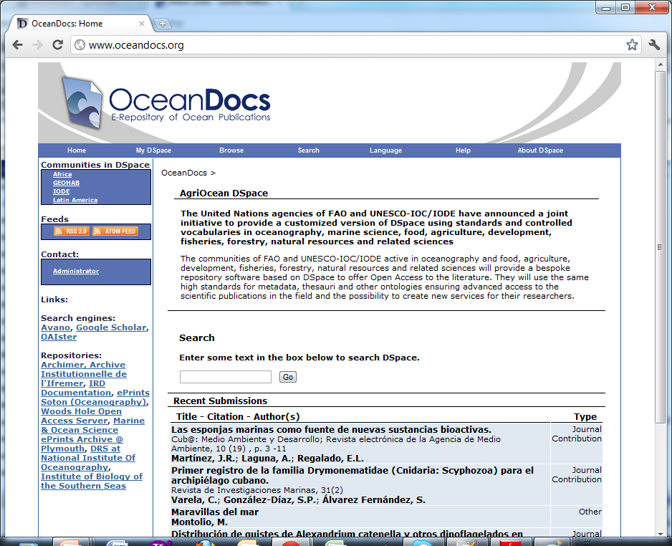
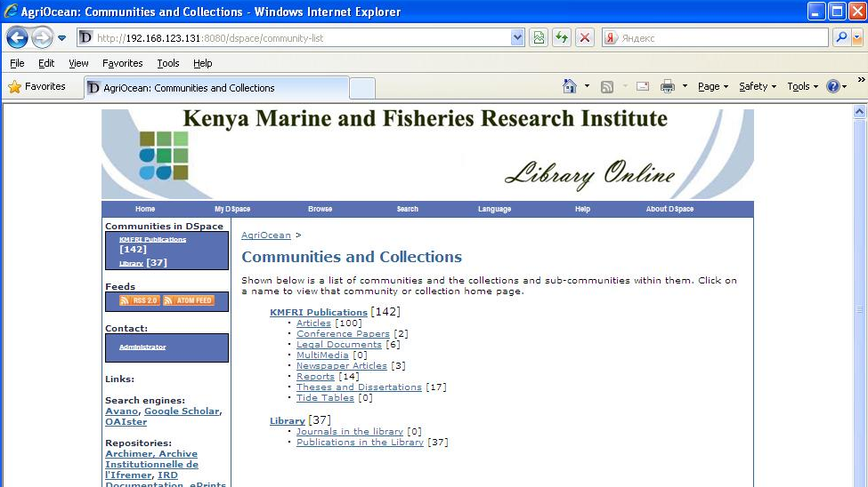
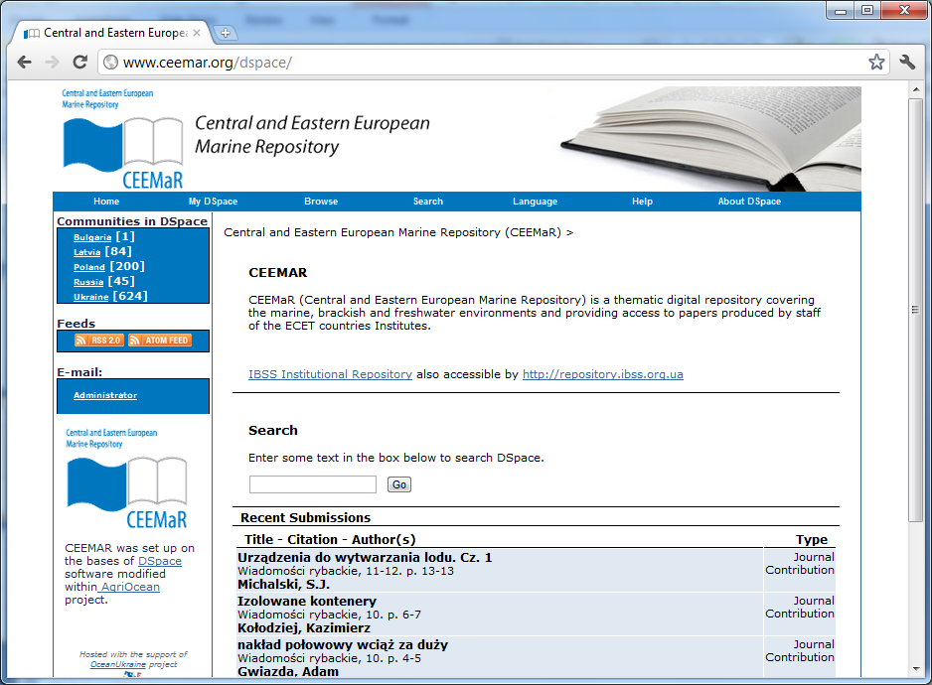
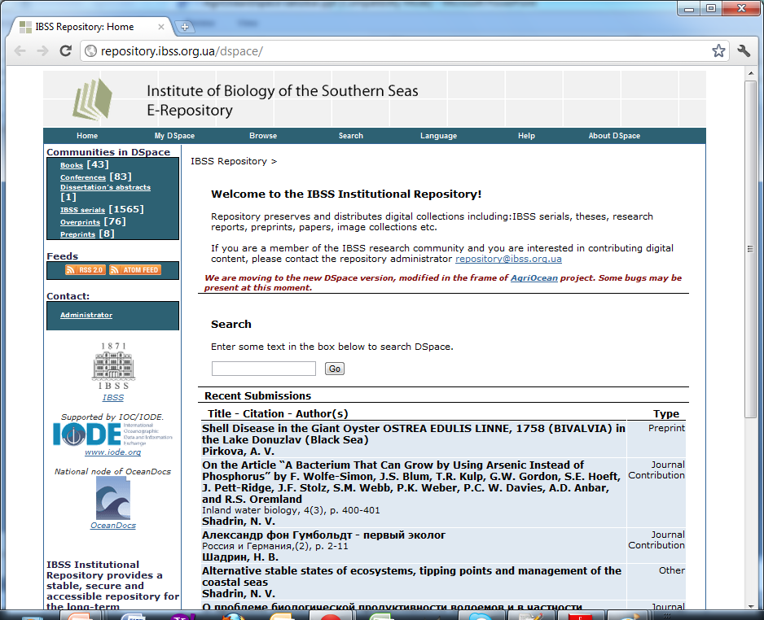

Slide 30
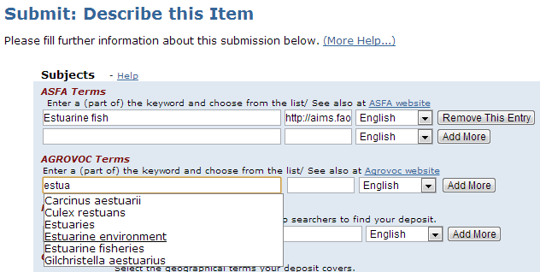
Authority control in AgriOcean DSpace
Journal titles, Subject terms (AGROVOC, ASFA)
Search option in alphabetic lists (as tables) with autosuggest possibility
For every vocabulary additional input field

Slide 31
Ontology plug-in: concept & implementation
Tool for submission of metadata
Search over different vocabularies:
Grouping of vocabularies is possible
submitter does not have to think about which vocabulary to use
Independent tool that can be integrated in different systems
It searches AGROVOC webservices, and an ASKOSI server containing the AGROVOC, ASFA, Plant Ontology and NERC-C19 (An Oceanographic Geographical ontology) ontology.
The broker can be extended to access any web service

Slide 32
Ontology plug-in
3rd party web services
Ontology plugin UI
Thesaurus search
webapp
Thesaurus web service 1
request
delegate
request
SKOS RDF/XML
concept(s)
Thesaurus web service 2
JQuery
Java
response
Request API
Search(thesaurus, query, language)
Thesaurus web service N
GetConcept(thesaurus, URI, language)
Notes:
The ontology plugin consists of 2 components. There is a user interface, and a search webapp. The UI is written in Jquery to create a responsive application, the search webapp contains the server side code and is written in Java.
When the user clicks the search button, the UI sends a request to the webapp for each thesaurus separately. That is, a search request specifies the name of the thesaurus, the search string and the language. The thesaurus webapp will respond with a list of matching concepts from the specified thesaurus. It returns a representation of these concepts in SKOS RDF/XML. The search webapp delegates each request to a 3rd party web service and then transforms the result it gets from that web service into SKOS, if needed. The 3rd party web service to use for a particular thesaurus is configurable via a Java properties file.
When the UI receives the matching concepts for a given search, it will display their preferred labels. When the user then clicks a preferred label, the UI will send a new request to the search webapp. It specifies the URI of the concept and the language. The search webapp responds with the SKOS concept with the given URI. That includes the preferred label, the narrower, broader, and related terms.

Slide 33
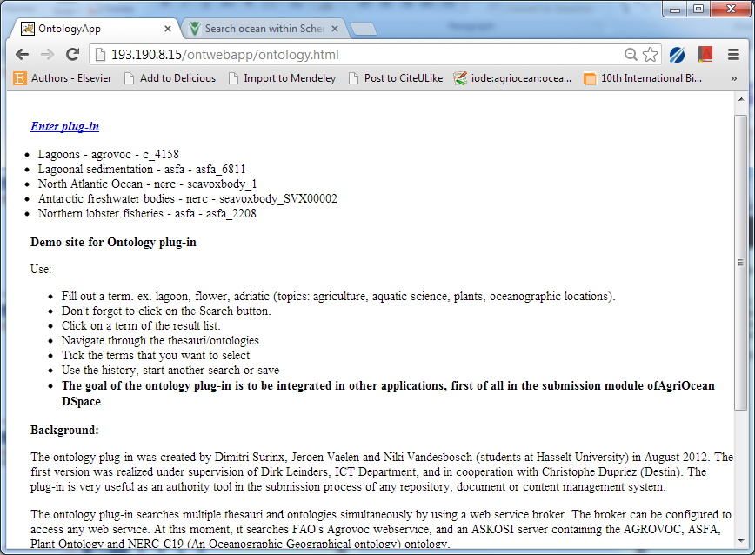
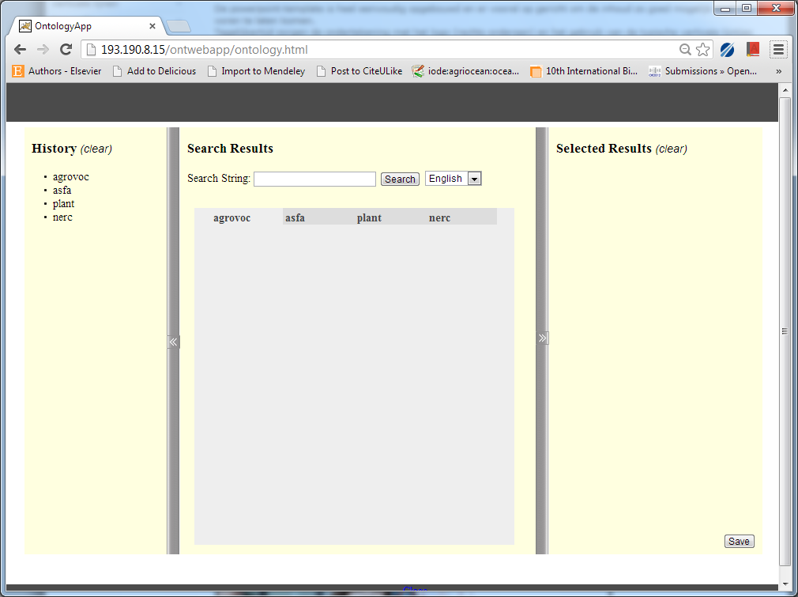
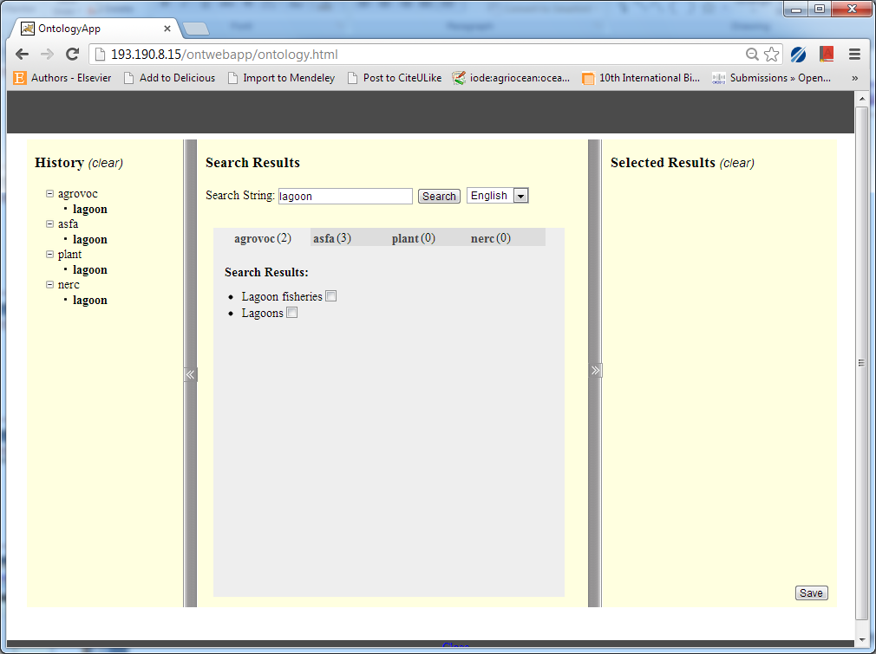
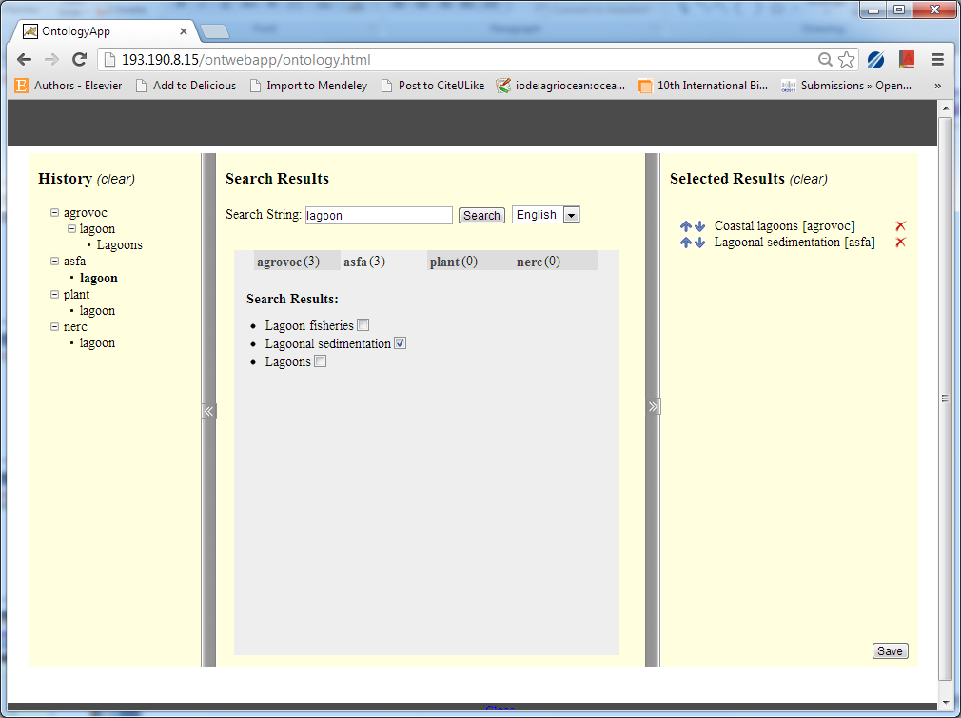
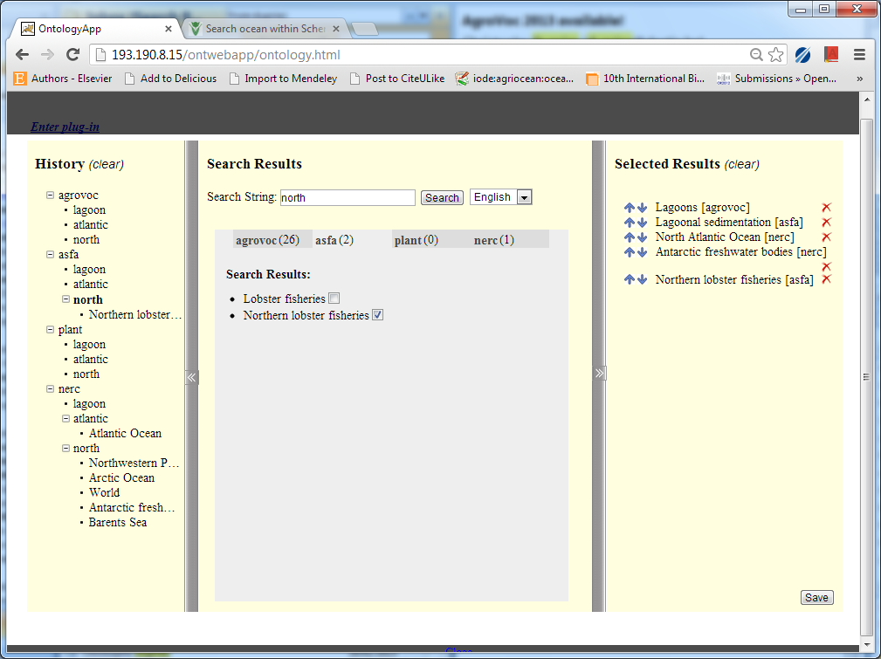
Demo at http://193.190.8.15/ontwebapp/ontology.html

Slide 34
Roadmap
Inclusion in AgriOcean Dspace 2.0 (March 2014)
Availability for other projects:
On Google Code
Options for further developments:
Extended view of relations:now only direct relations
Graphical interface
Other implementation

Slide 35
Ontology plug-in
The ontology plug-in was created by Dimitri Surinx, Jeroen Vaelen and Niki Vandesbosch (students at Hasselt University) in August 2012.
The first version was realized under supervision of Dirk Leinders, ICT Department, and in cooperation with Christophe Dupriez (Destin – ASKOSI - http://www.destin-informatique.com/ASKOSI/).

Slide 36
More information at
AIMS
http://aims.fao.org/
AGROVOC
http://aims.fao.org/standards/agrovoc
AgriOcean Dspace
http://aims.fao.org/agriocean-dspace
Ontology plug-in
Source code is as open source Apache License 2.0 at https://code.google.com/p/ontology-plugin/
Access to the Ontology Plug-in demo at http://193.190.8.15/ontwebapp/ontology.html

Slide 37
Thanks!
Turn of questions

