Slide 1
OEKCS
Knowledge Standards and Services

Slide 2
3 Organizational Outputs
F06G204 : Stakeholder learning, knowledge sharing and information access on practices and technologies, including biotechnologies, facilitated for agricultural innovation.
H04G210: Standards, methods and tools for producing and managing statistics, information and knowledge are developed, maintained and made available
Lead!
X02G204 - FAO better applies Web standards and utilizes knowledge sharing approaches in its programmes and projects and shares knowledge/expertise across the organization in accordance with the Corporate Knowledge Strategy

Slide 3
6 Products/Services
F06G20405: Facilitation of CIARD framework components on technologies, policies and good practices, and services associated with the CIARD-RING, advocacy and capacity development
F06G204.
F06G20406: Facilitated access to scientific and technical information on agricultural innovation in member countries through the AGRIS database and associated services, methodologies, and capacity development support for open repositories
H04G21004: Guidelines, registries, advice and collaboration on agricultural information management through the AIMS community platform
H04G210
H04G21005: Standards and methodologies for agricultural information management for stakeholders in member countries
H04G21006: Tools and infrastructures for agricultural information management for stakeholders in member countries
X02G204
X02G20409: Support to FAO technical units in the implementation of standards and tools for information management

Slide 4
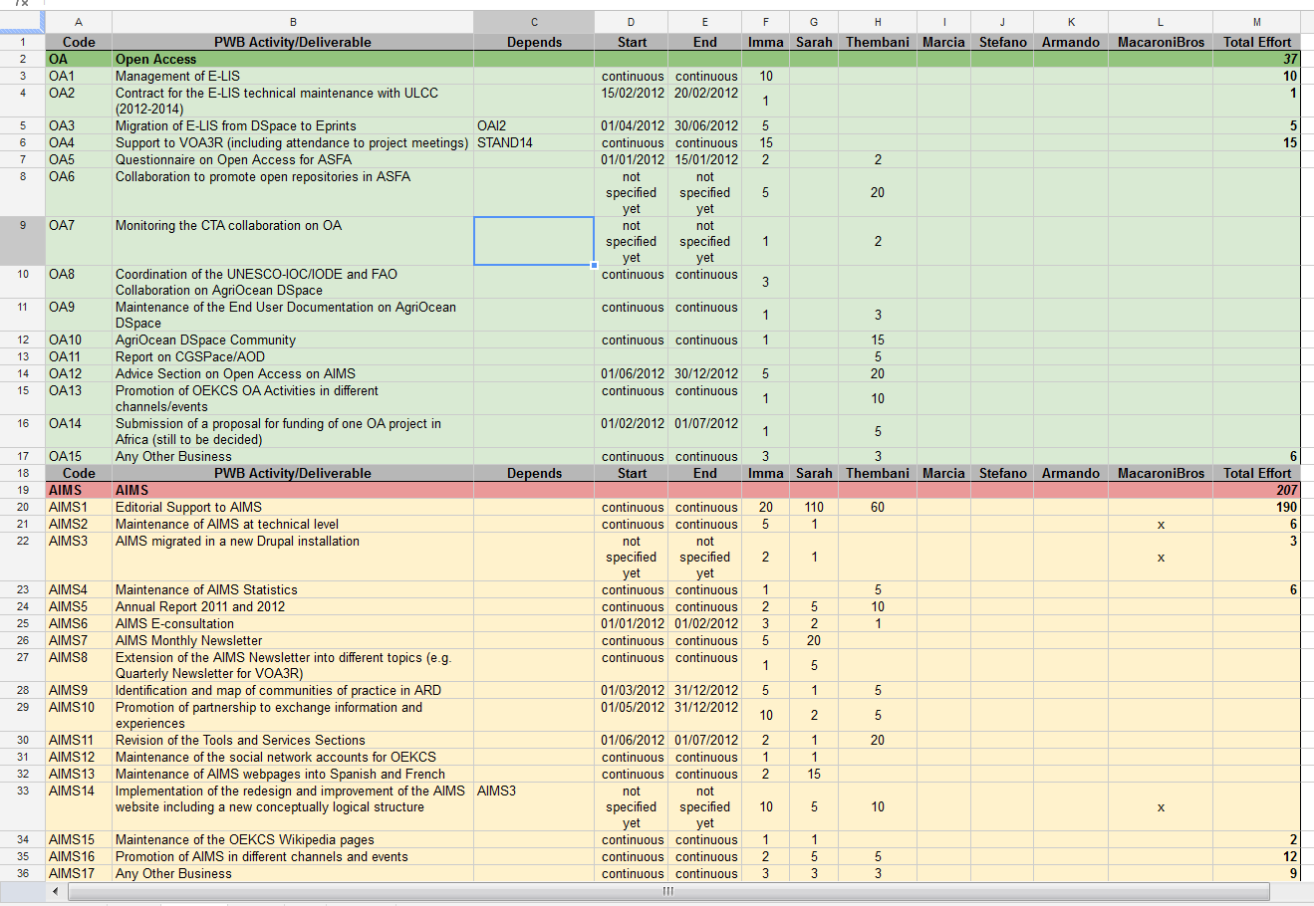
2012: 130 Deliverables
Notes:
Obviously we will not present all these Deliverables! ☺ But we have precise planning for every Product/Services, what we will deliver!

Slide 5
Highlights
F06G20406: Facilitation of CIARD framework components on technologies, policies and good practices, and services associated with the CIARD-RING, advocacy and capacity development
F06G204 : Stakeholder learning, knowledge sharing and information access on practices and technologies, including biotechnologies, facilitated for agricultural innovation.
CIARD - RING
F06G20405: Facilitated access to scientific and technical information on agricultural innovation in member countries through the AGRIS database and associated services, methodologies, and capacity development support for open repositories
AGRIS
H04G210: Standards, methods and tools for producing and managing statistics, information and knowledge are developed, maintained and made available
H04G21004: Guidelines, registries, advice and collaboration on agricultural information management through the AIMS community platform
AIMS
Lead!
H04G21005: Standards and methodologies for agricultural information management for stakeholders in member countries
AGROVOC
X02G204 - FAO better applies Web standards and utilizes knowledge sharing approaches in its programmes and projects and shares knowledge/expertise across the organization in accordance with the Corporate Knowledge Strategy
H04G21006: Tools and infrastructures for agricultural information management for stakeholders in member countries
VocBench
X02G20409: Support to FAO technical units in the implementation of standards and tools for information management
Data.fao.org

Slide 6
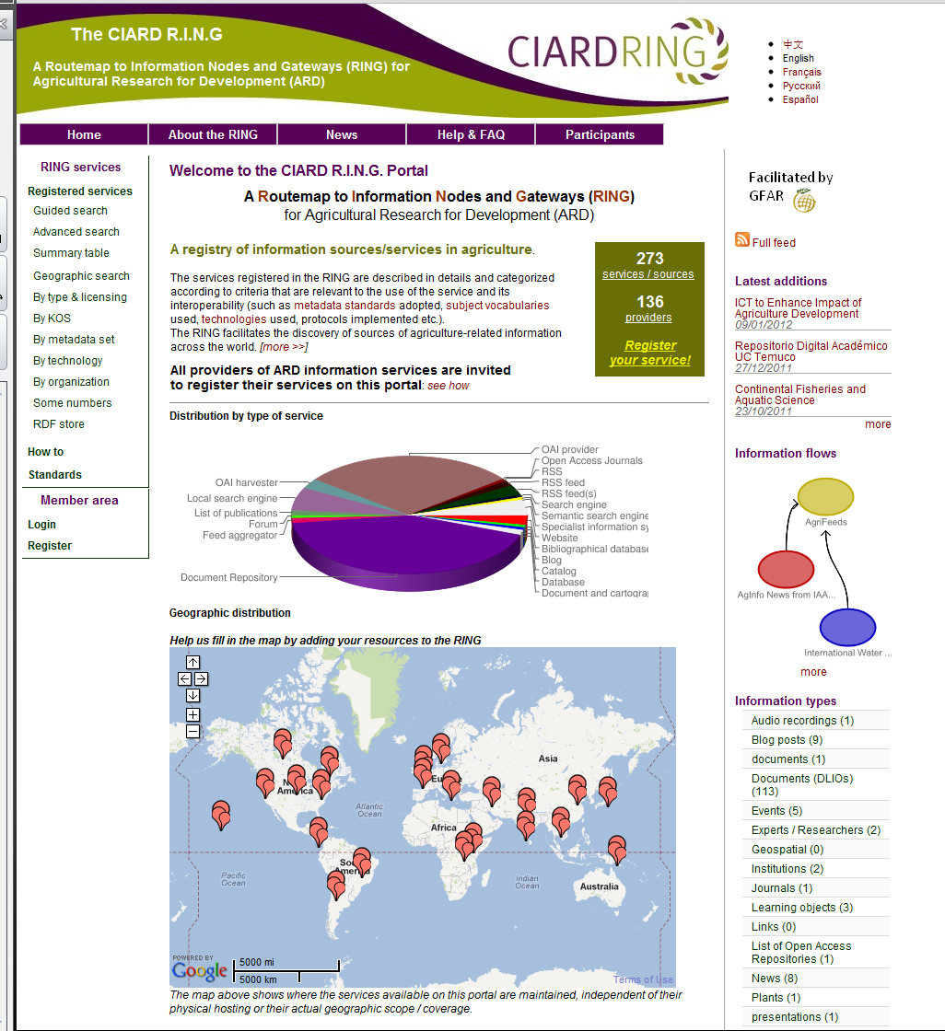
F06G20406: http://ring.ciard.net/
CIARD - RING
Directory of Data Providers and Information Services in ARD

Slide 7
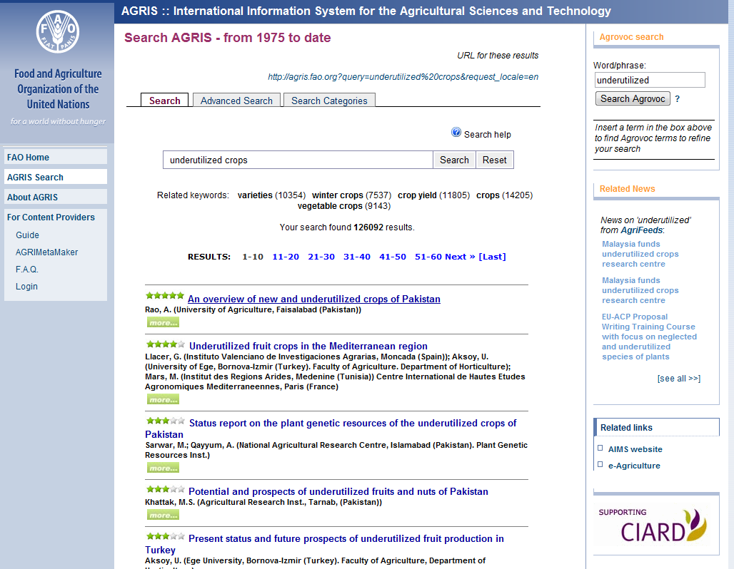
F06G20405: http://agris.fao.org
AGRIS
Access to scientific publication in Agriculture

Slide 8
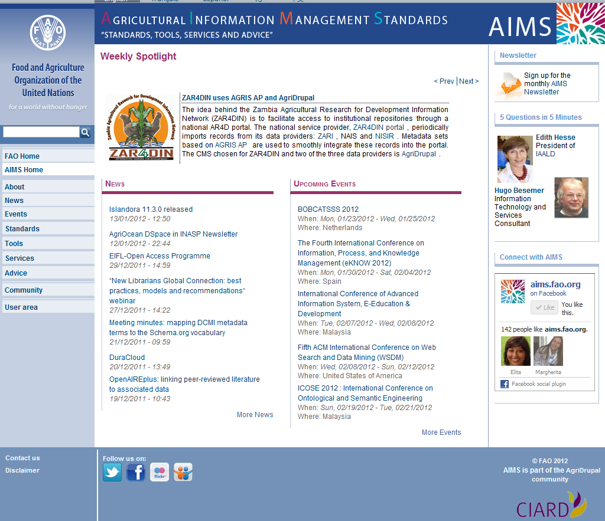
H04G21004: http://aims.fao.org
AIMS
Center of excellence for accessing and discussing Agricultural Information Management Standards, tools and methodologies

Slide 9
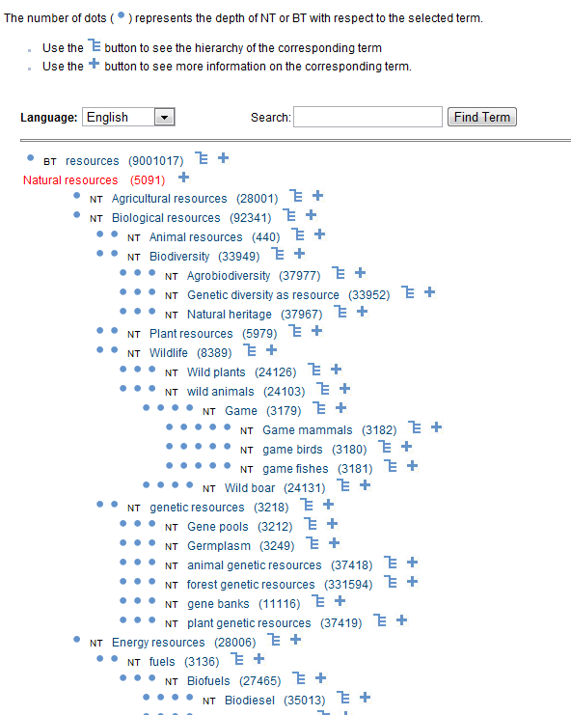
H04G21005: Standards http://aims.fao.org/standards/agrovoc/functionalities/hierarchy
AGROVOC
Representing Agricultural Knowledge

Slide 10
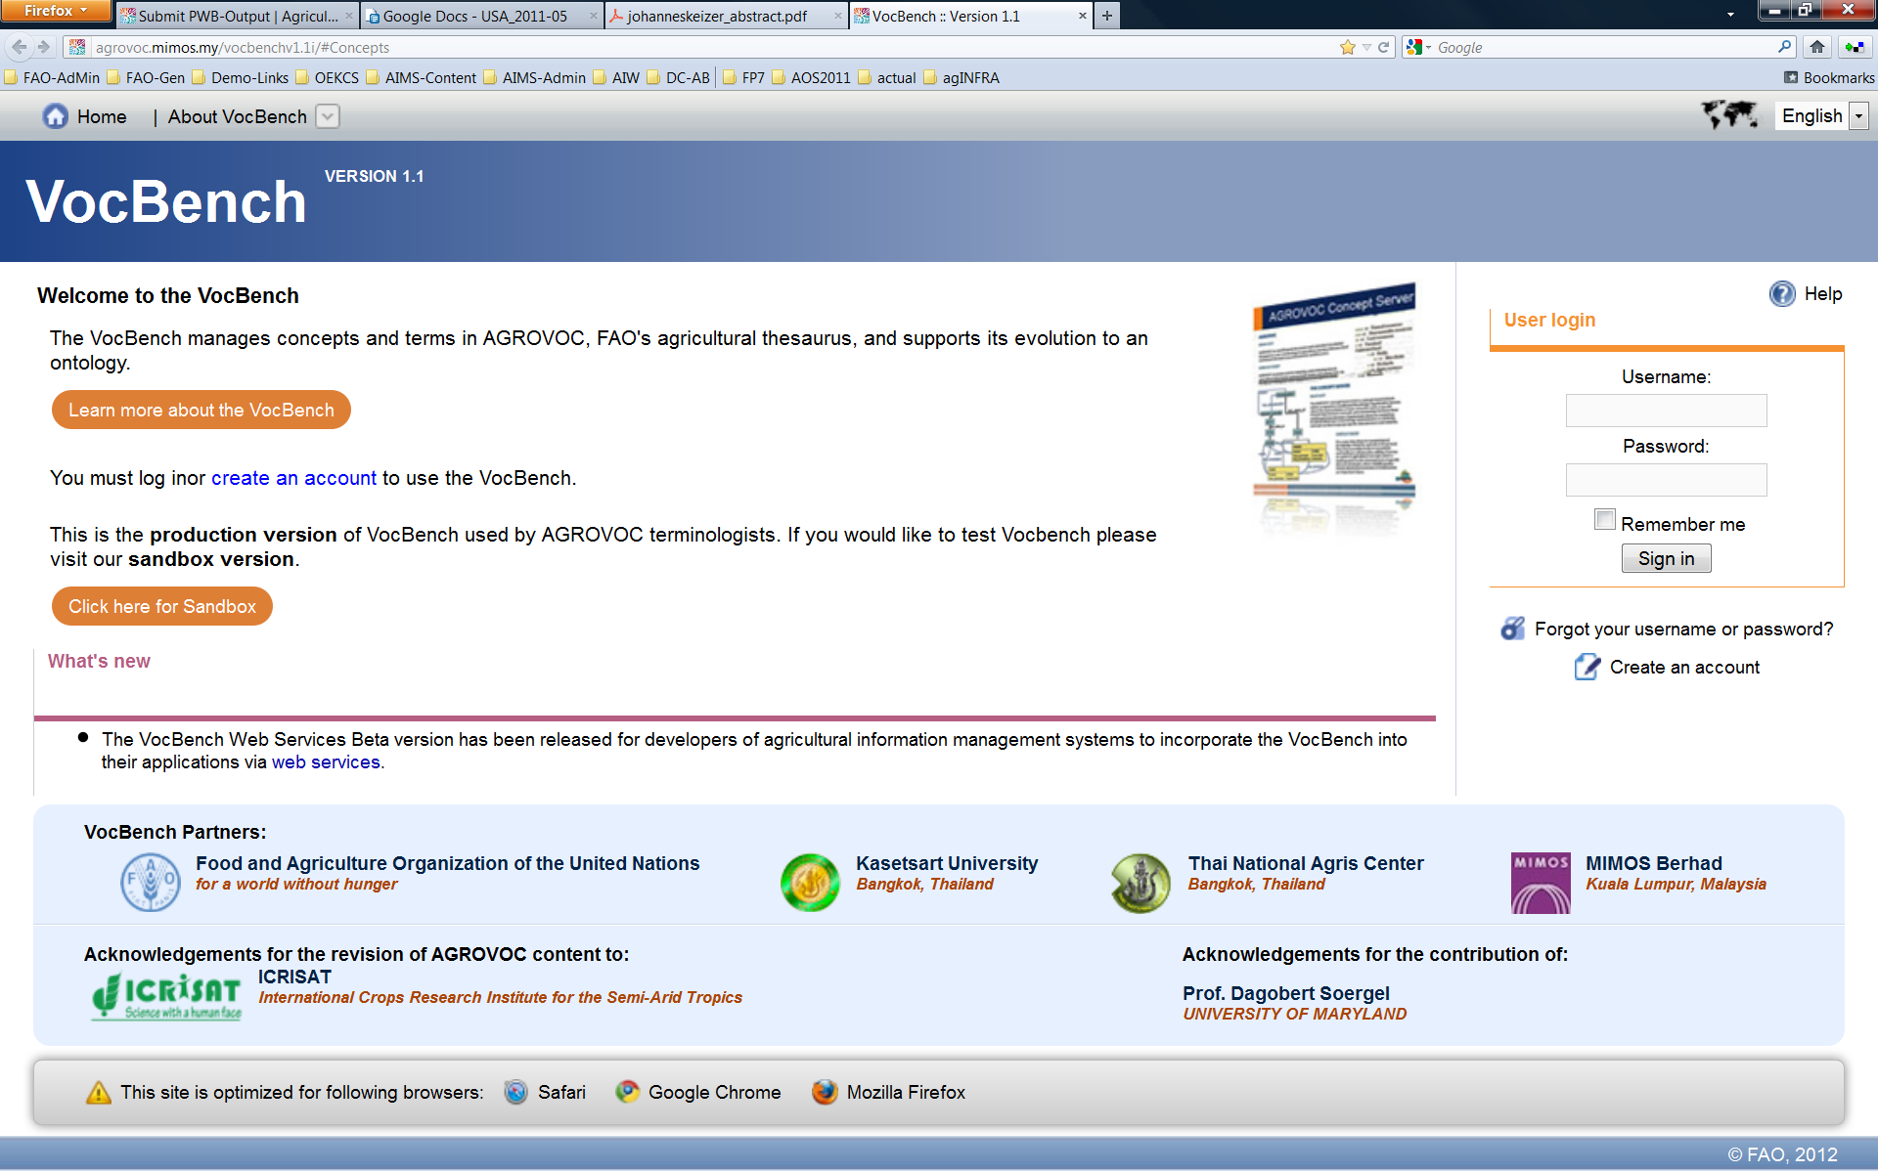
H04G21006: Tools http://agrovoc.mimos.my/vocbench/
VocBench
Environment for collaborative maintenance of vocabularies

Slide 11
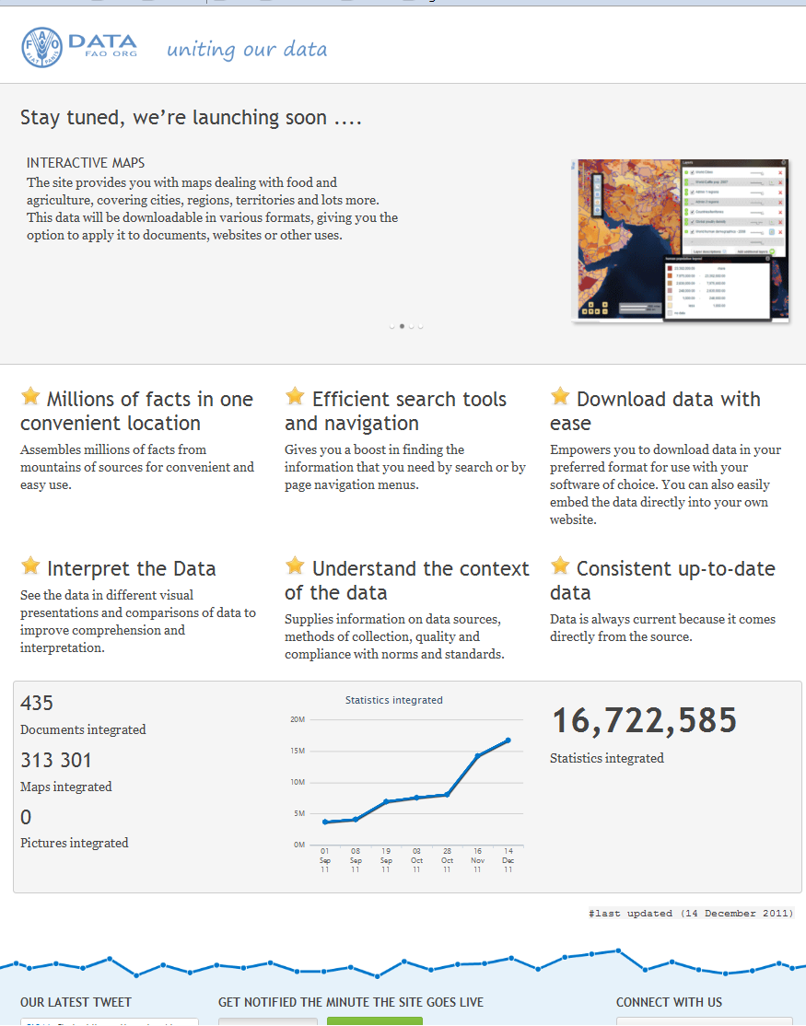
X02G20409:
http://data.fao.org

Slide 12
Resources
Resources | 2010/2011 | 2012/2013
Staff | 9 | 8
P4 | 1 | 1
P3 | 2 | 3
P2 | 3 | 2
P1 | 1 | 0
G5 (*) | 1 | 0
G4 (*) | 0 | 1(*)
G3 | 1 | 1
NSR
RP-Allotment | 450.000 | 250,000
MDF
Secondments | 70,000
Trustfund | 30,000 | 250,000

Slide 13
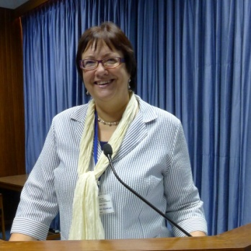
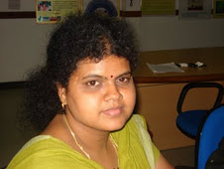
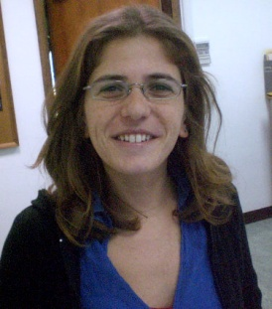
People
Gudrun
thembani
Aline
Fabrizio
Marcia
johannes
Imma
Stefano
Sachit
Sarah
Antonella
Maria
Yves
Giampaolo
Armando
Lavanya
Ahsan
Valeria
Caterina
Adam

