Slide 1
AgriDrupal training workshop DAY 2
Lusaka, 22 March 2011
Valeria Pesce

Slide 2
DAY 2
Techniques, formats and technologies for information exchange
Metadata, “vocabularies” and namespaces
XML, CSV, machine-readable formats / notations
Syndication (RSS) and harvesting
OAI-PMH
RDF and the semantic web
A broader concept of “feeds”
Recommended standards in the agricultural field
Subject indexing: Agrovoc (and other thesauri and reciprocal mapping)
Other KOS (the VEST registry on AIMS)
Description:
DLIOs: Agris AP (-> RDF recommendations)
News (RSS); Events and vacancies (RSS + AgEvent AP and AgJobs AP)
People (FOAF); Organizations (FOAF, AiDA)
HANDS-ON session 3: customizing the layout and style of the website

Slide 3
Techniques, formats and technologies for information exchange

Slide 4
Metadata
“Data about data”: the elements that describe an entity of a specific type, e.g. for a person:
First name: Valeria
Last name: Pesce
Country: Italy
…
Agreeing on a metadata set means agreeing on a common set of elements to exchange information of a certain type

Slide 5
Metadata “vocabularies”
Formalization of a metadata set in a series of agreed “property names” for metadata elements, e.g. for a person:
firstname: Valeria
lastname: Pesce
country: Italy
…
Vocabularies allow machines to share metadata using the same “labels” for metadata properties

Slide 6
Namespaces
Metadata elements only have a specific meaning within the vocabulary where they were created; these vocabularies are defined in “namespaces” and elements must associated with a namespace in order to have some meaning
dc:date means the “date” element in the Dublin Core namespace (shortened in the dc: prefix)
ags:dateStart means the “dateStart” element in the AgMES namespace (shortened in the ags: prefix)
Namespaces are needed in order to avoid duplication of element names and misinterpretation
e.g. “source” element in different namespaces:
dc:source in Dublin Core identifies the source book/document of a document
rss:source in RSS identifies the URL from where the harvested item comes

Slide 7
Notation, syntax, encoding
Metadata elements can be expressed in different notations: examples:
CSV comma separated values (->Excel) firstname,lastname,country Valeria,Pesce,Italy Justin,Chisenga,Ghana
XML <firstname>Justin</firstname> <lastname>Chisenga</lastname> <country>Ghana</country>
Vocabularies can be defined in specific “definition files” (DTDs, XML schemas, RDF schemas…) that provide machine-readable rules for structure, syntax and encoding, e.g. the nesting of the “ags:locationCountry” element inside the “ags:location” element, or ISO encoding for countries and languages, specific date formats etc.
<ags:location> <ags:locationCountry>GHA</ags:locationCountry> </ags:location>

Slide 8
RSS
Really Simple Syndication.
RSS feed: a file that exposes syndicated contents from a website (or any source) in a way that can be read by RSS readers. RSS is a metadata set defined in the RSS namespace and is expressed in XML
RSS specification:
http://cyber.law.harvard.edu/rss/rss.html

Slide 9
RSS feed item
Example of RSS feed with bibliographical data
...
<item>
<title>Web 2.0 Principles and Best Practices. An O'Reilly Radar Report</title>
<author>John Musser</author>
<author>Tim O'Reilly</author>
<description>What does Web 2.0 mean to your company and products? What are the risks and opportunities? What are the proven strategies for successfully capitalizing on these changes?</description>
<pubDate>Sun, 01 November 2006 00:00:00 GMT</pubDate>
<guid>ISBN:0-596-52769-1</guid>
<link>http://radar.oreilly.com/research/web2-report.html</link>
<category>technology</category>
<category>web development</category>
</item>
...

Slide 10
Extended RSS feed
Example of RSS feed extended with Dublin Core
<rss version="2.0" xmlns:dc="http://purl.org/dc/elements/1.1/">
<channel>
<title>O'Reilly publications</title>
<link>http://www.oreilly.com/</link>
<item>
<title>Web 2.0 Principles and Best Practices.</title>
<link>http://www.marchal.com/en/</link>
<dc:creator>Marchal</dc:creator>
<dc:date>2006/11/01</dc:date> <dc:identifier>ISBN:0-596-52769-1</dc:identifier>
<dc:rights>Copyright 2006 O'Reilly</dc:rights>
</item>
</channel>
</rss>

Slide 11
OAI-PMH
In the context of the OA (Open Access) Initiative, the technical protocol called OAI-PMH (Protocol for Metadata Harvesting) is the agreed protocol to harvest metadata from repositories. The OAI-PMH architecture is based on OAI providers (or data providers) and OAI harvesters (or service providers).
An OAI provider maintains one or more repositories (web servers) that support the OAI protocol as a means of exposing metadata. It provides data as well as OAI services. OAI services include implmenentations of the six OAI verbs (Identify, ListSets, ListMetadataFormats, ListIdentifiers, ListRecords, and GetRecord ).
An OAI harvester is a service that can import metadata from a remote OAI provider

Slide 12
Feeds and OAI-PMH in AgriDrupal
Different types of feeds are available by default (and highlighted by the standard RSS and XML icons) in AgriDrupal from the web pages listing the following types of contents:
News and events RSS feeds: in the homepage and in the corresponding web pages:
News: Newsroom > Our news
Events: Newsroom > Our events
Vacancies: Newsroom > Our vacancies
Documents RSS feeds and Agris AP XML export: in The Documents > Catalog page
See slides from Day 3 to see how these feeds were created. In the same way, other feeds can be created.
Implementing an OAI data provider that implements all the “verbs” required by the OAI-PMH standard requires a lot of programming: in AgriDrupal, this has already been done for you. The AgriDrupal OAI-PMH interface as data provider is available at: http://yourwebsite/oai2 (in your local installations: http://localhost/agridrupal075/oai2)
See slides from Day 4 to see how to configure and share your OAI data provider.

Slide 13
A broader concept of “feeds”
Calendar
News reader
Blog
Website
Advanced service
Web 1.0
Web 2.0
FEEDS
Any machine-readable file that can feed other information systems using a standard metadata set and notation is a FEED

Slide 14
Feeds in Drupal
Drupal considers any machine-readable file containing metadata and using a standard notation as a FEED containing records that can be imported in the system
The Feeds module can import / harvest from:
RSS feeds
XML files
CSV files The condition is that the metadata in the file and the metadata in one of the content types in the system match
This module can both harvest from a URL or import from an uploaded file

Slide 15
Recommended standards
in the agricultural field

Slide 16
Subject indexing
Agrovoc http://aims.fao.org/website/AGROVOC/sub
AGROVOC is the world’s most comprehensive multilingual agricultural vocabulary. Downloaded over a thousand times a year by dozens of countries it is in daily institutional use to index and search documents, web pages and digital objects. Organized as a concept scheme, AGROVOC contains close to 40,000 concepts in over 20 languages covering subject fields in agriculture, forestry and fisheries together with cross-cutting themes such as land use, rural livelihoods and food security.
Agrovoc is available:
As a browse / search web interface: http://aims.fao.org/website/Search-Terms/sub
As a dataset to download (in different formats): http://aims.fao.org/website/Download/sub
As “web services” that other applications can call to integrate Agrovoc terms: http://aims.fao.org/website/Web-Services/sub
Other “subject indexing vocabularies” or “Knowledge Organization Systems” (KOS): http://aims.fao.org/vest-registry

Slide 17
Metadata sets
“Application Profiles” for describing:
Documents (DLIOs) (Agris AP)
Learning objects (AgL-AP)
News (RSS)
Events (Ag-Event AP)
See http://aims.fao.org/website/Application-Profiles/sub
Other metadata sets: http://aims.fao.org/vest-registry e.g. People: FOAF

Slide 18
Services that exploit metadata standards in agriculture
The AGRIS search engine: http://agris.fao.org allows to search for documents in the document repositories that export their data in the Agris AP format
AgriFeeds http://www.agrifeeds.org allows to search and browse news, events and vacancies from sources that expose their data in RSS and the Ag-Event AP

Slide 19
Brief introduction to
RDF and the semantic web
RDF:
Resource Description Framework

Slide 20
RDF basics
Subject – predicate – object
RDF assumption: Triples like this can represent and describe everything
Adam – is a – person
Adam – knows – Giampaolo
Giampaolo – lives in – Rome
<resource A> – <has title> – “War and Peace”
<resource A> - <has author> - <person A>
<person A> - <has name> - “Lev Tolstoj”

Slide 21
RDF graph

Slide 22
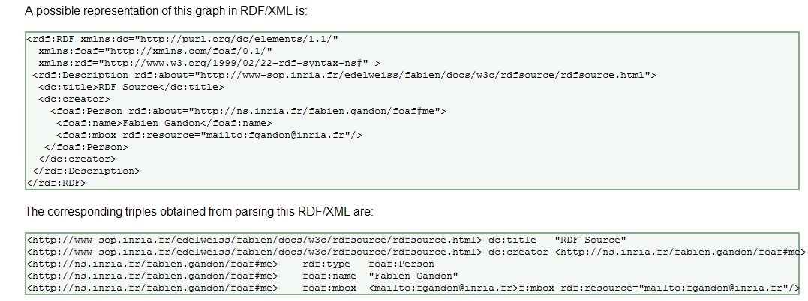
RDF/XML serialization and corresponding triples

Slide 23
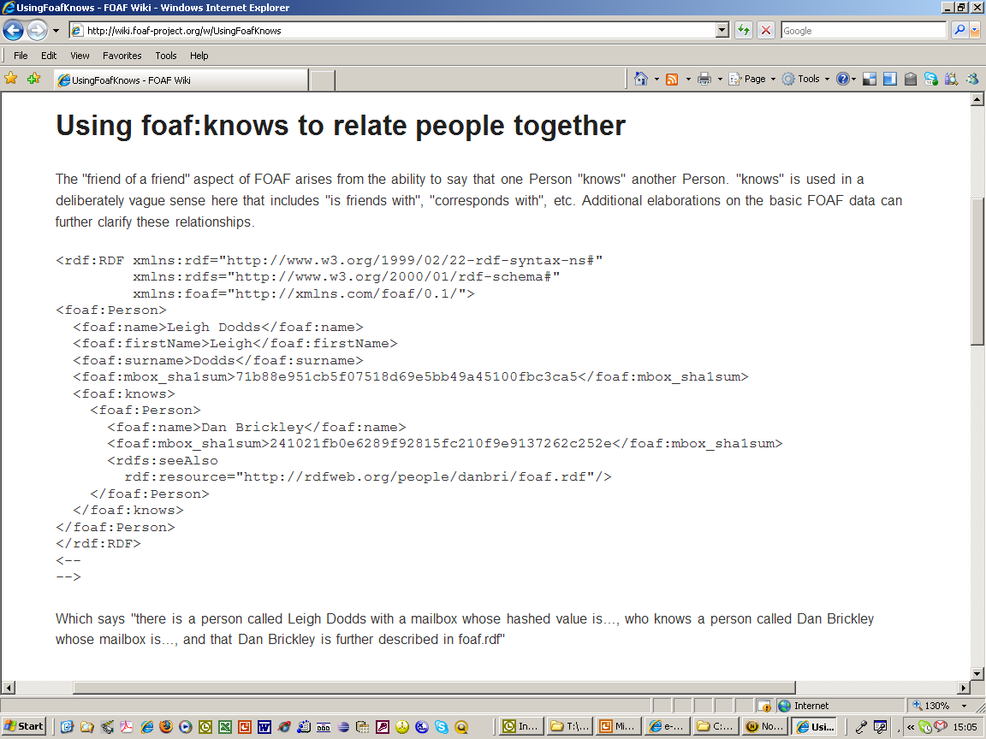
FoaF example in RDF/XML

Slide 24
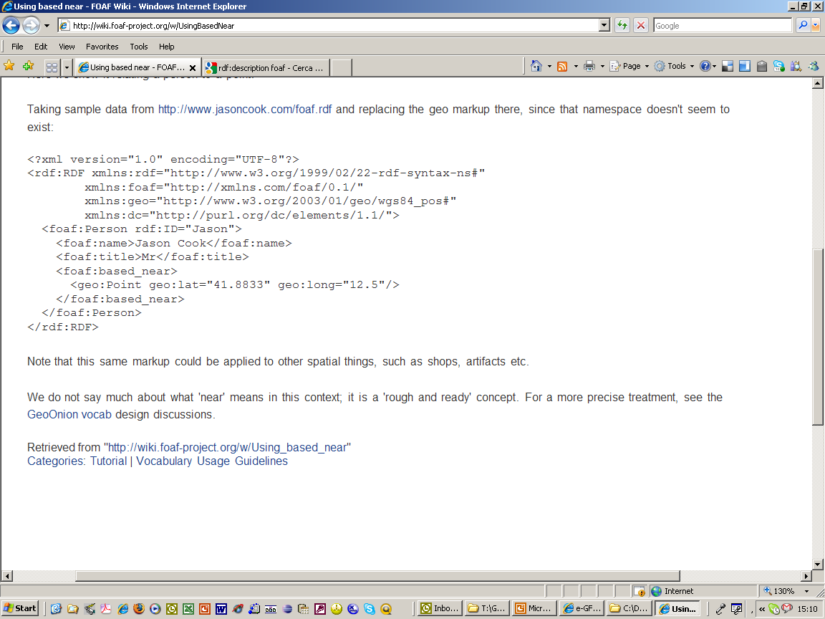
FOAF + Geo in RDF/XML

Slide 25
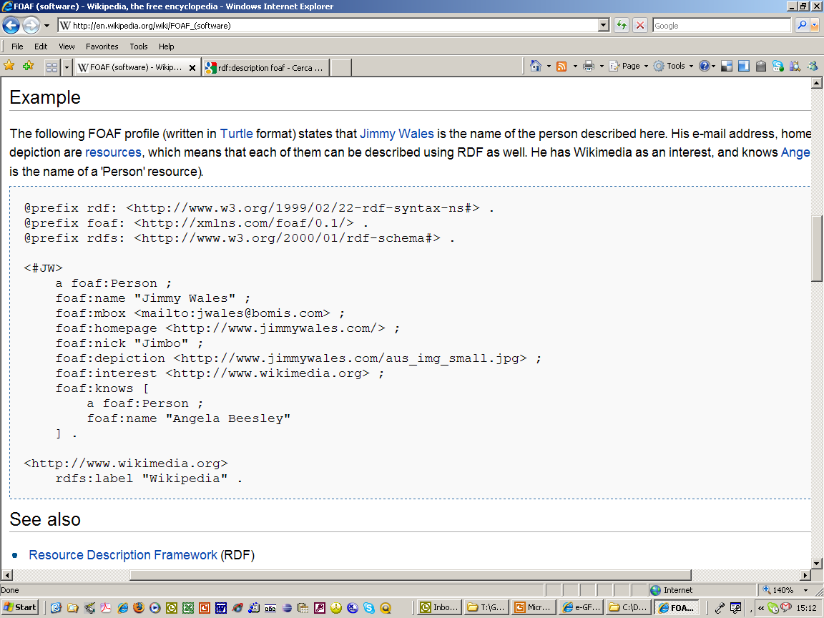
FOAF example in Turtle notation

Slide 26
Useful links on RDF
RDF
http://en.wikipedia.org/wiki/Resource_Description_Framework (forget about Alt, Bag, List, Seq, nil: they are a nightmare and luckily in Linked Data they are deprecated!)
On blank nodes:
http://en.wikipedia.org/wiki/Blank_node (also blank nodes are not recommended in Linked Data, but they are a very important concept in RDF)
On FOAF:
http://en.wikipedia.org/wiki/FOAF_(software)
If you have the Data Browser plugin for Firefox, open this in Firefox:
http://danbri.org/foaf.rdf
or open it with one of the online RDF navigators like Tabulator (also available as Firefox plugin): http://www.w3.org/2005/ajar/tab

Slide 27
HANDS-ON session 3: customizing the layout

Slide 28
Customizing the layout - 1
Themes The theme you select for your Drupal installation controls the page layout (header, columns) and style (colors, sizes, borders etc.). It also defines which “regions” are available for placing your “blocks” (see next slide) Administer > Site building > Themes Theme folder under /agridrupal075/sites/all/themes To customize the layout (columns, regions), file page.tpl.php in the theme folder. To customize colors, font styles etc., file style.css in the theme folder The last section of the style.css file allows even non-technical users to set some simple style rules (font color, background color, font size) for certain elements of the website. This section can be found at the end, below the line that says: /****** EASILY CUSOMIZABLE STYLES ****/ After saving style.css, if you don’t see your changes reflected on the website, go to Administer > Site configuration > Performance and click on “Clear cached data”

Slide 29
Customizing the layout - 2
Blocks Blocks are small “boxes” containing either static or dynamic content that can be placed in one of the available “regions” of the website. By default, the following “regions” are available: header, left column, right column, content (right below the main central area of the page), footer. Administer > Site building > Blocks In the Blocks list, you will find:
Dynamic blocks (e.g. the latest 3 news items, or the latest documents added to the system) that have been created with Views
Blocks automatically created by Drupal and Drupal modules
All the available menus
Static blocks that can be created from the Blocks page by clicking on the “Add block” tab
You can place each of these blocks in any of the available regions by selecting the region in the corresponding dropdown box. Under each region, you can drag and drop blocks to re-arrange the order.
Tutorial on using Blocks: http://drupal.org/getting-started/6/admin/build/block

