Slide 1
AgriDrupal training workshop DAY 1
Lusaka, 22 March 2011
Valeria Pesce

Slide 2
DAY 1 - Morning
What is AgriDrupal, what is Drupal
Why AgriDrupal in the context of the ZAR4DIN project
AgriDrupal for document repository management: a first overview
Drupal content management architecture
HANDS-ON session 1: Getting started with AgriDrupal
Basic customization of our installations: title, logo, slogan, email address, informational web pages (using the rich editor, creating internal hyperlinks, understanding path aliases)
Customizing navigation menus in our installations
Defining a content model and metadata models: Content types and fields
Content model and contents: content types and “nodes”
Defining knowledge organization systems::Taxonomies
Displaying dynamic lists of contents: Views

Slide 3
DAY 1 - Afternoon
AgriDrupal content model
Pages, news, events, vacancies
Institutions and experts
Documents, authors, journals
Relations between contents
HANDS-ON session 2: Simple content types and simple views
Analyze the event and document content types
Create new nodes (document, event)
Analyze the Latest news View and the Document simple search view
Implement a sample view for events

Slide 4
About Drupal and AgriDrupal

Slide 5
The Drupal Content Management System (CMS)
Drupal is a free software package that allows an individual or a community of users to easily publish, manage and organize a wide variety of content on a website.
Drupal is open-source software distributed under the GPL ("GNU General Public License") and is maintained and developed by a community of thousands of users and developers.
www.drupal.org

Slide 6
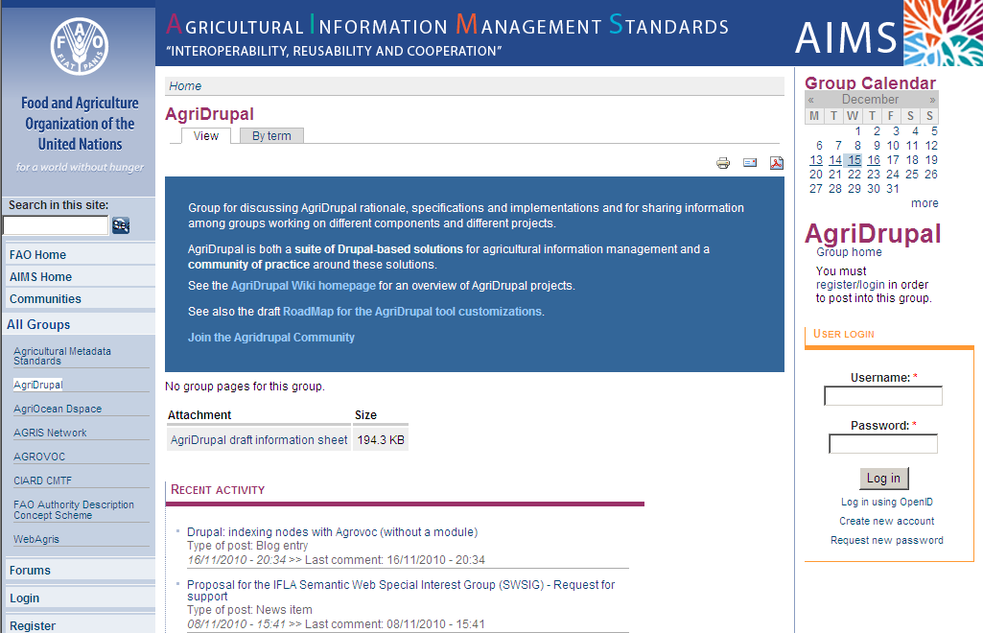
The AgriDrupal community
The AgriDrupal community is made up of people who work in the community of agricultural information management specialists and have been experimenting with IM solutions with the Drupal CMS
The community interacts using the AIMS community platform: http://aims.fao.org/community/home

Slide 7
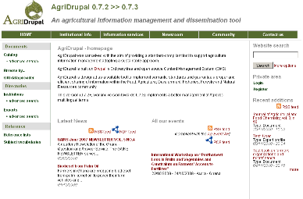
AgriDrupal solutions and “demo tool”
One or more “reference” installations of AgriDrupal including all or only selected functionalities can be made available
for testing purposes
for adoption by Institutions looking for a full-fledged tool for integrated information management and dissemination

Slide 8
Why a community on IM solutions
One of the main obstacles towards a more efficient management and sharing of agricultural knowledge is the lack of good standard-compliant tools whose adoption and maintenance is really sustainable
In-house developed solutions, outsourced solutions and proprietary platform-based solutions are not easily sustainable
IM needs of agricultural institutions are in most cases very similar and duplicating efforts is costly
Joining efforts around solutions based on a mainstream open source platform is more sustainable

Slide 9
Why Drupal
More and more implementations of Drupal solutions in the community of agricultural information managers:
Cornell libraries in the US
AgroPedia Indica
“Rangeland West” project in the US
three CG Centers (ILRI, IFPRI, ICRAF), soon also ICARDA
San Yat Sen University in Guangzhou
Condesan in Peru
E-agriculture
our team in FAO
Because of the flexible and extensible Drupal content management model

Slide 10
“Agri” Drupal
Drupal best practices and configurations to manage contents that are commonly of interest to the agricultural community (Institutions, researchers, projects, project outputs / publications, technologies, events)
Drupal recommended configurations to use agriculture-specific metadata and vocabularies
Drupal best configurations to automate exchange between installation
Drupal best configuration of community functions for agricultural communities (vocabularies, links with other contents)

Slide 11
AgriDrupal is not a tool
Not software “development”, but platform customization
Customizations implemented / tested / recommended by the AgriDrupal community
Recommendation of best practices and distribution of specific configurations
As little programming code as possible
Advanced features:
Re-use and configuration of modules maintained by the community
New modules developed → committed to the community

Slide 12
AgriDrupal is “also” a tool
One or more “reference” installations of AgriDrupal including all or only selected functionalities will be made available
for testing purposes
for adoption by Institutions looking for a full-fledged tool for integrated information management and dissemination
Institutions adopting an AgriDrupal reference installation will become the owners of the installation and will be responsible for its maintenance
The AgriDrupal community will make new or improved solutions available for all institutions that have
adopted the AgriDrupal tool
adopted solutions recommended by the community

Slide 13
Other Drupal setups in agriculture
Agropedia Indica: http://agropedia.iitk.ac.in/
ILRI: http://www.ilri.org/
IFPRI: http://www.ifpri.org/
ICRAF: http://www.icraf.org/
Mann Library at Cornell: http://www.mannlib.cornell.edu/
WorldAgInfo portal: http://www.worldaginfo.org/
KAINET: http://www.kainet.or.ke/
FPMU Bangladesh: http://182.160.112.236/agridrupal/
E-agriculture: www.e-agriculture.org
CIARD website: http://www.ciard.net
CIARD RING website: http://ring.ciard.net

Slide 14
AgriDrupal in the
ZAR4DIN project

Slide 15
AgriDrupal in the ZAR4DIN project
ZAR4DIN: creating document repositories in the participants Institutions for sharing full-text documents with metadata → AgriDrupal allows to create metadata (bibliographic records) compliant with library standards and attach full-text resources to the metadata
ZAR4DIN: sharing records between the involved Institutions and creating a portal that gives access to records from all the participating Institutions → AgriDrupal can export records in a a standard formats and import / harvest on the fly records from other AgriDrupal. installations (and from any source that uses a standard format). AgriDrupal also allows to manage a website with portal functionalities.

Slide 16
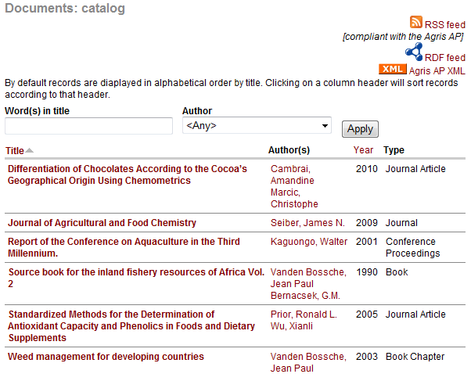
AgriDrupal for document repository management
Example of document repository management in Drupal: simple search
Through an extended use of metadata and workflows, a CMS can perform the functions of specialized software.

Slide 17
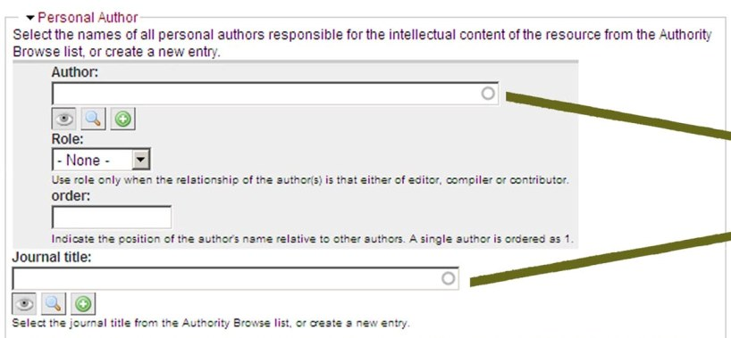
AgriDrupal for document repository management
Input form (cataloguing form) compliant with library standards.
Example: metadata and authority control for authors and journals

Slide 18
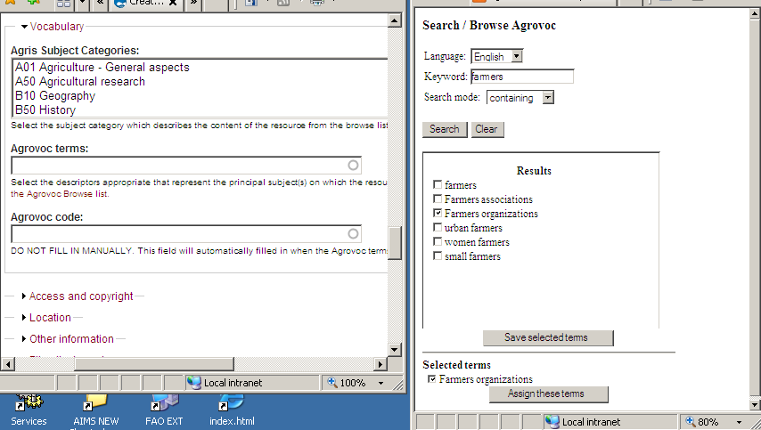
AgriDrupal for document repository management
Standard vocabulary for subject indexing: Agrovoc (http://aims.fao.org/website/AGROVOC/sub).
Essential for consistent subject indexing and for a common subject-browsing interface in the portal.
>> click <<

Slide 19
Drupal content management architecture

Slide 20
Drupal for content management (1)
1. Content types
Drupal has the in-built capacity to treat any kind of user-defined content type: from simple web pages to events, contacts, bibliographical records or any custom content types → extensible with no programming
Content types define entities.
Users can decide which content types are needed in their systems
For each content type, users can decide which fields are needed for describing the entity (in other words, a suitable metadata set can be designed) → customizable with no programming

Slide 21
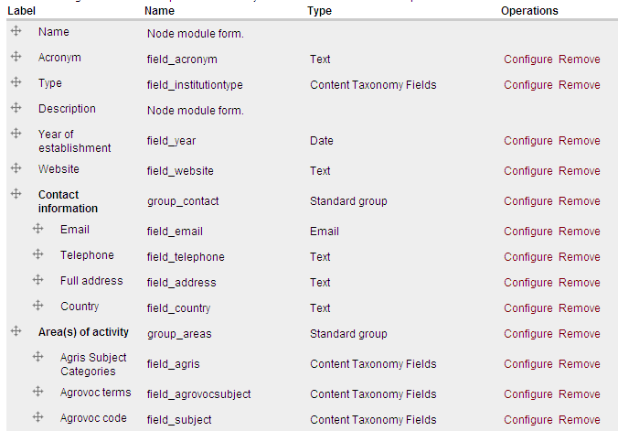
E.g.: metadata to describe Institutions

Slide 22
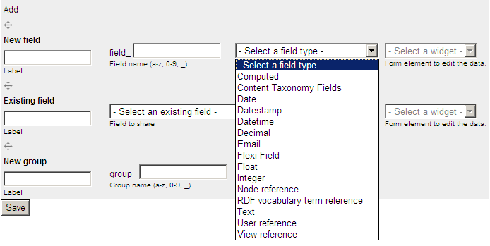
Adding metadata elements / form fields

Slide 23
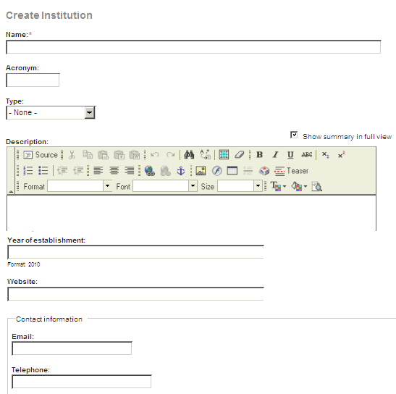
Metadata → input form

Slide 24
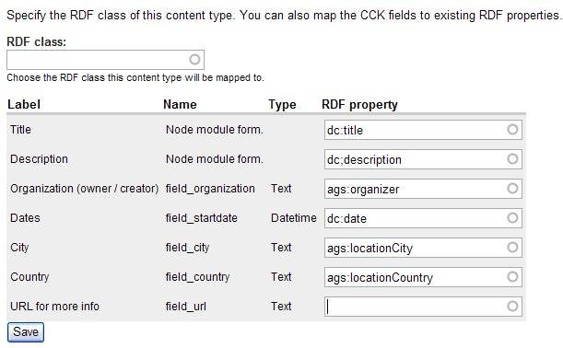
Mapping metadata to standard vocabularies
E.g.: mapping the metadata describing an event to the AgEvent Application Profile metadata set. (See AIMS Application Profiles here: http://aims.fao.org/website/Application-Profiles/sub)

Slide 25
Drupal for content management (2)
2. Nodes
The contents stored in Drupal are called “nodes”. When creating a new node, the user has to select one of the existing content types defined in the system. Content types are the definitions of metedata for describing an entity / a class, while nodes are the actual contents, or an “instance” of the entity / class.

Slide 26
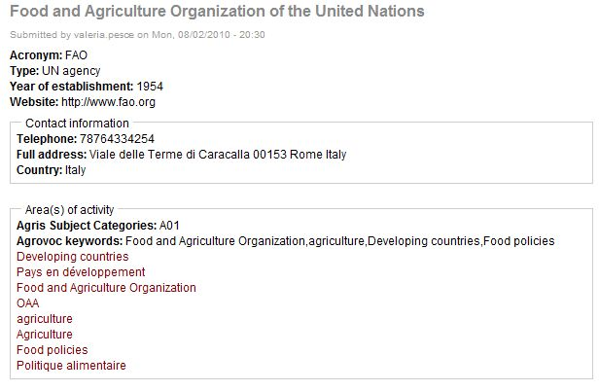
Example of a node of type Institution

Slide 27
Drupal for content management (3)
3. Taxonomies
Users can define taxonomies (or categories, classification systems, tagging systems) that can be used to “tag” or index any contents. Adding / editing terms in taxonomies can be done through a simple user interface Taxonomies can be hierarchical

Slide 28
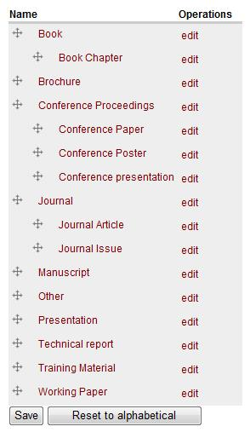
Taxonomy
Example of taxonomy:
Document types
For categorizing documents

Slide 29
Drupal for content management (4)
4. Views
Drupal has the in-built capacity to provide any number and type of views (displays, lists) over the stored contents: from simple lists of news to tables with selected columns to search engines to calendars to feeds and XML/RDF exports

Slide 30
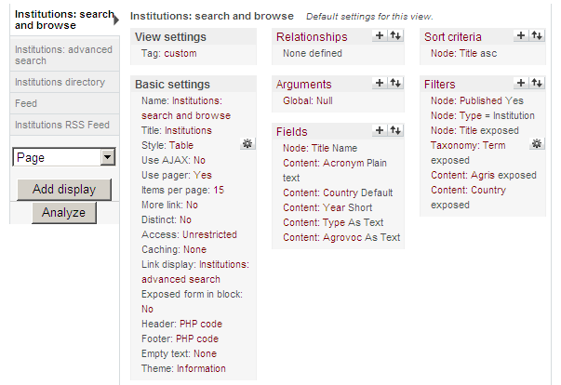
Building views on data
The User Interface for creating / editing Views
Users can set all the parameters of which contents, how many, filtered by which criteria they want to see on a page

Slide 31
Example of view: table

Slide 32
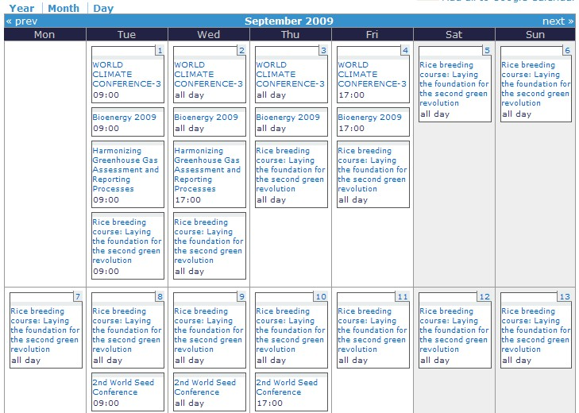
Example of view: calendar view

Slide 33
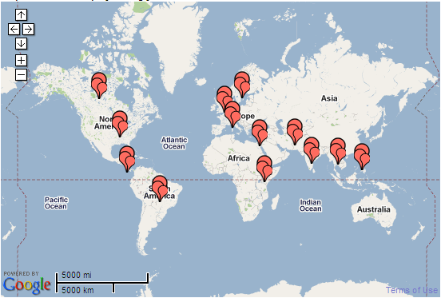
Example of view: map

Slide 34
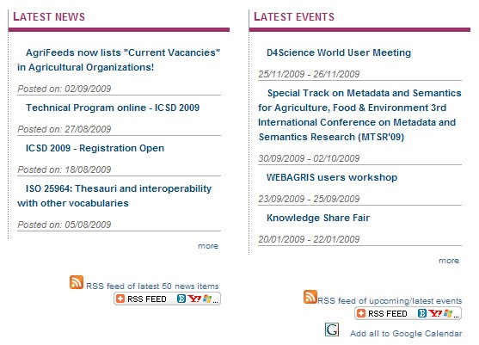
Example of view: blocks

Slide 35
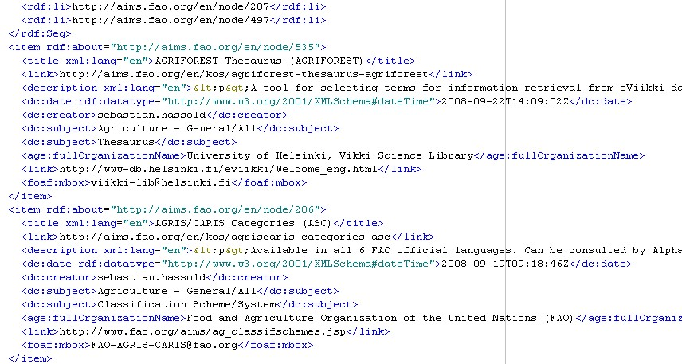
Example of view: RDF feed

Slide 36
AgriDrupal content model
Using the Drupal content management infrastructure, AgriDrupal implements a “content model” that is suitable for an agricultural information management system. This means that an AgriDrupal installation already contains the necessary content types, taxonomies and views to manage a basic agricultural information system. This is the added value of AgriDrupal compared to a vanilla installation of Drupal.
This content model allows to manage contents that are commonly of interest to agricultural Institutions (Institutions, researchers, projects, project outputs / publications, news, events)

Slide 37
AgriDrupal content model
Document
journal
Page
Journal
News item
author
Author
Expert
corporate author or publisher
Event
Corporate body
Institution
conference
Conference
Content type
Document type
Field (node reference)
DOCUMENT REPOSITORY
RESEARCH MANAGEMENT
Taxonomies
Agrovoc terms
Document types
Free tags
Agris Categories
Institution types

Slide 38
Drupal CMS: software architecture
Manage content model and content
Browse
Feeds / exports
CLIENTS
Feeds / exports
Web services
Notifications
SERVER
MySQL / PostgreSQL
Database layer
Drupal modules
PHP libraries
← Programming support
Apache / IIS
← Web server
Unix / Linux / BSD / Solaris / Windows / Mac OS X support
← OS

Slide 39
HANDS-ON session 1
Basic customization of our installations: title, logo, slogan, email address, informational web pages (using the rich editor, creating internal hyperlinks, understanding path aliases)
Customizing navigation menus in our installations
For hands-on sessions, slides will only provide the relevant links and screenshots in your AgriDrupal installation
In some cases, important instructions given during the course will be repeated in the slides

Slide 40
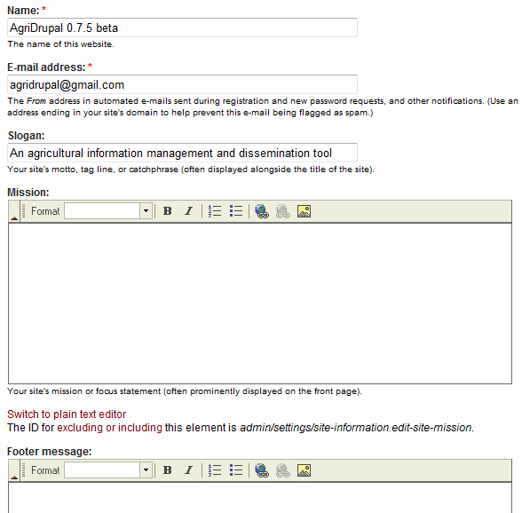
Configuring site information
Administer > Site configuration > Site information
http://localhost/agridrupal075/admin/settings/site-information

Slide 41
Managing navigation menus
http://localhost/agridrupal075/admin/build/menu Administer > Site building > Menus
Do not remove the Drupal default menus
You can link each menu item to the system path of a page (e.g. node/x) or to its path alias (e.g. home), or to the view path if you are linking to a view
You can then decide where your menus will be placed through the Blocks page (see slides from Day 2): http://localhost/agridrupal075/admin/build/block Administer > Site building > Blocks
Drupal guide on Menus: http://drupal.org/node/120632

Slide 42
HANDS-ON session 2
Analyze the event and document content types
Create new nodes (document, event)
Analyze the Latest news View and the Document simple search view

Slide 43
Relevant AgriDrupal internal links
Content types Administer > Content > Content types http://localhost/agridrupal075/admin/content/types
Views Administer > Site building > Views http://localhost/agridrupal075/admin/build/views
Add contents: “Private area” menu on the right > Add new resource then select the content type http://localhost/agridrupal075/node/add

Slide 44
Learning material
Get started with Drupal: http://drupal.org/documentation/customization/tutorials/beginners-cookbook
Drupal tutorial on Views: http://drupal.org/documentation/modules/views
Video tutorial on Content types and Views: http://awakenedvoice.com/learn/drupal/cck-and-views

