Slide 1
Cómo seleccionar estrategias de codificación adecuados para la producción de LOD habilitado para datos bibliográficos
LODE-BD
Marcia L.Zeng Kent State University Estados Unidos de América
Imma Subirats Organización de la Naciones Unidas para la Alimentación y Agricultura
Webinar@AIMS, XX XX, 2013
Notes:
Gracias por venir a este Webinar. Esperamos que el Webinar proporcione datos útiles para producir Datos Abiertos Vinculados (LOD) para datos bibliográficos habilitados.

Slide 2
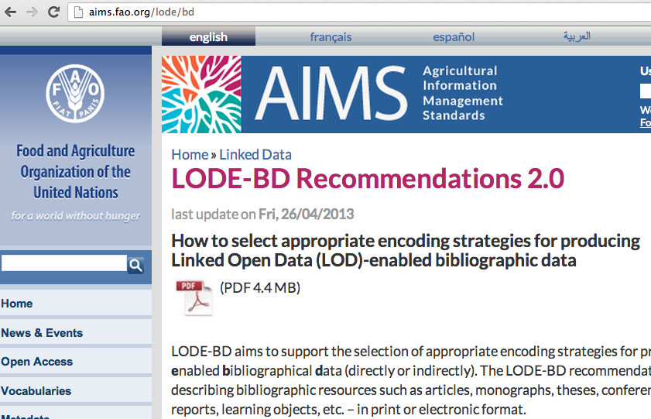
Background
8 repositories
(13 countries, 17 institutions )
Virtual Open Access Agriculture & Aquaculture Repository
Task: turning the bibliographic data
-- from an ad-hoc modeled database in a silo
→ to the data in a standardized metadata repository …
→ heading to the LOD universe
http://aims.fao.org/lode/bd
Notes:
Some background of why LODE-BD was created.
VOA3R is a social platform mainly oriented for researchers in agriculture & aquaculture. It integrates open access institutional research repositories using the AGROVOC thesaurus combined with terminologies specific to research methods.
At the beginning of the project, there are 8 repositories from 13 countries, and data was collected from 17 institutions.
In order to provide the data providers of these open repositories with a set of recommendations, FAO AIMS created this LODE-BD report, aiming to support the selection of appropriate encoding strategies for producing meaningful Linked Open Data (LOD)-enabled bibliographical data (LODE-BD).

Slide 3
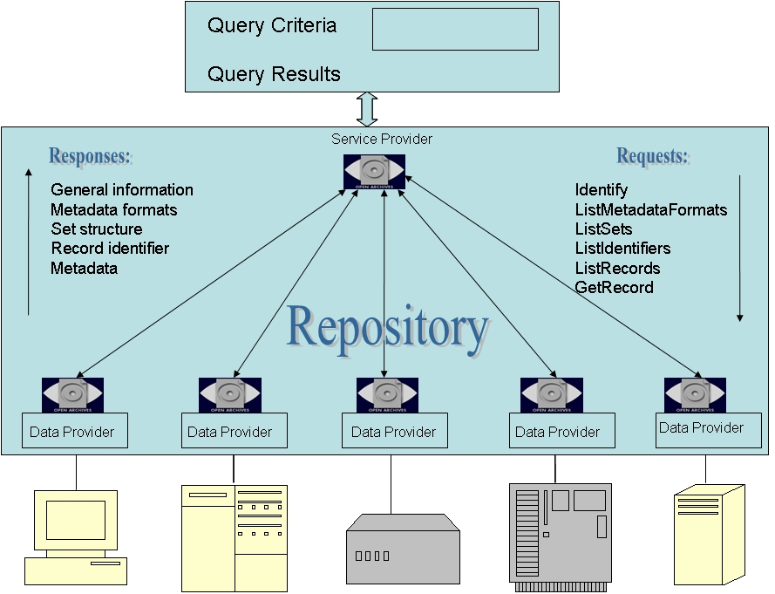
Service Provider
Data Provider
8 repositories
(13 countries, 17 institutions )
Notes:
This is an illustration of the situation. Data providers are from various places and would like to use a central platform to share data.

Slide 4
Questions from the data providers:
To make local data into a Linked Data dataset ---
What metadata standard(s) to follow?
What is the minimal set of properties to include to insure meaningful data sharing?
Is there any metadata model or application profile for my data?
What data values to provide – plain text string or Unified Resource Identifier (URI)?
How to encode our data in order to move from a local database to a Linked Data dataset?

Slide 5
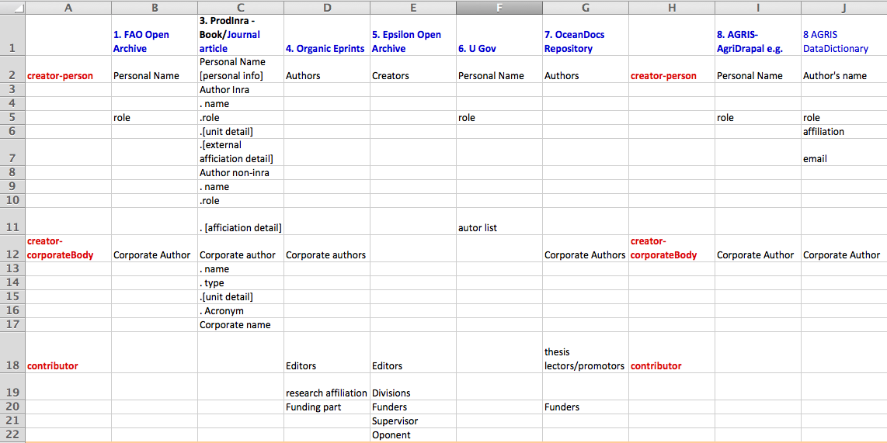
Various standards were applied
Example: <Responsible Body>- related data fields from 8 data providers
Everyone uses an ad-hoc in-house format.
Notes:
When data dictionaries were collected and a survey results were analyzed, we found that everyone uses an ad-hoc in-house format for their data structure.
Just from this <responsible body> related information, you can see that there were almost no agreement.

Slide 6
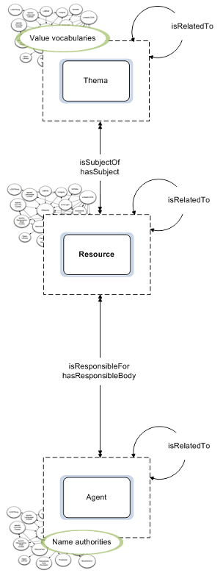
Step 1. Know your own data model
About…
Resource
Agent
Notes:
LODE-BD believes that a conceptual model would help to establish an overall picture of involving entities and relationships in bibliographic descriptions.
In a broader context, the use of a similar conceptual model among data providers should also help foster a common understanding of the involving data models. Thus, LODE-BD uses a simple conceptual model based on three entities: resource, agent and thema.
Major relations can be identified between a resource instance (e.g. an article or a report) and the agent(s) (e.g. a personal author or a research team) that are responsible for the creation of the content and the dissemination of the resource, as well as the thema(s) (e.g. things that being the subjects or topics of an article).

Slide 7
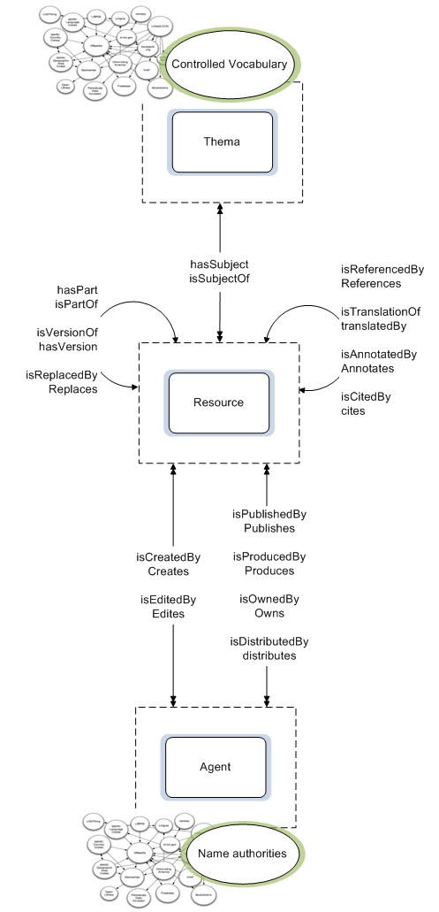
Notes:
The illustration on the right side gives more details, and can be extended as needed.
The model provides sufficient capabilities for data providers to present their content (such as in document repositories and library catalogues) for sharing in the traditional environment or transferring to the Linked Data environment.
The models convey the following meanings:
Basic entities and their relationships. The resource entity is the centre of every description here. The model does not exemplify the types of sub-entities, e.g., the sub-entities of resource would be various resource types. Relationships are established between the resource entity and two other major entitles: agent and thema.
Relationships between instances within the same entity. Relationships between instances of an entity also exist. For example, a resource may be related to another resource. An agent may be related to another agent. Such relationships are demonstrated in the model.
Relationships between instances of different entities. Relationships between any pair of instances vary and can be found at different levels. The sample relationships illustrated in Figure 2 are demonstrative and may apply at different levels of the bibliographic resource entity. For example, an agent may provide the funding for the creation of an original work, for the translation of a work, or the production of a new format of a translation.
Control of values. Authority control is considered an important element of the model. The agents, regardless of their roles in relation to a resource, should be managed through name authority files. Concepts, topics, and geographic places as the themas of a resource should be controlled with value vocabularies. Although not emphasized in the model for the authority control of the titles of bibliographic resource given the context of this report, it is also a logical step that resource uniform titles also be controlled.

Slide 8
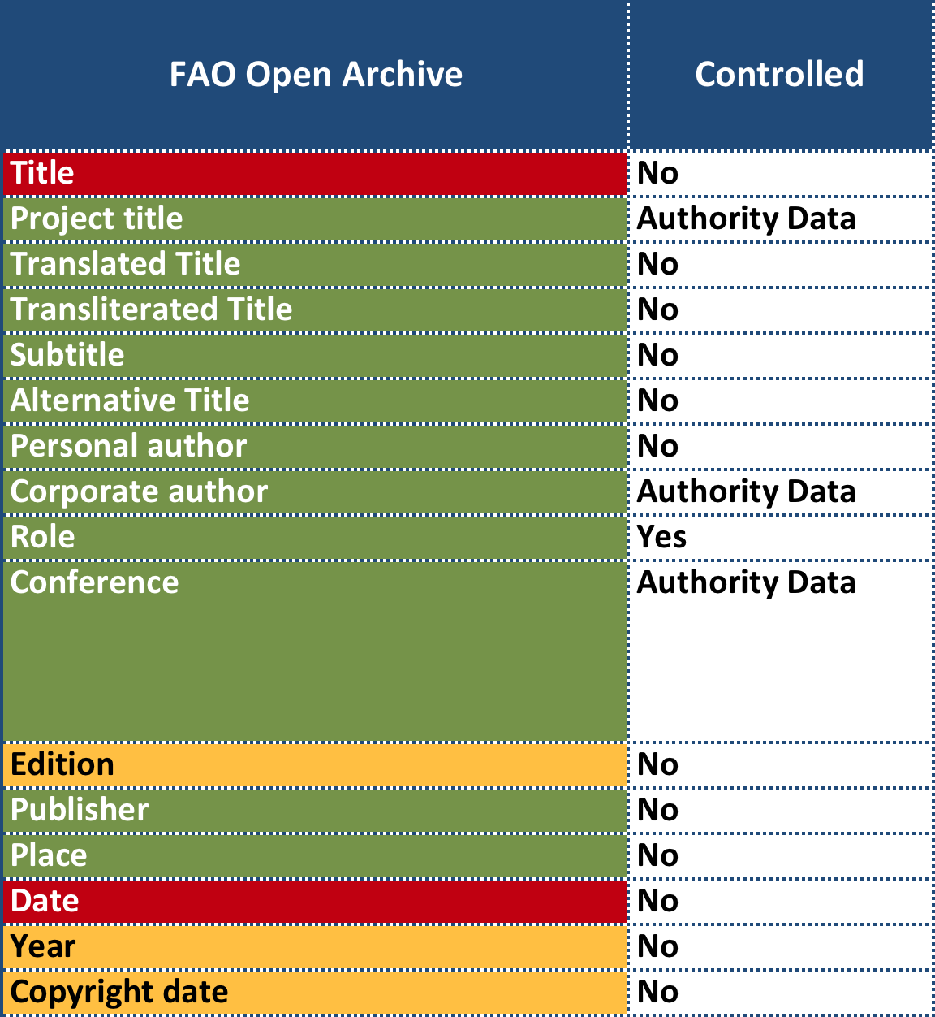
Step 2. Map your data fields to the LODE-BD chunks and properties
Once
Once or many
0 or once
0 or many
Notes:
Every data provider has its own data dictionary. In order to have everyone speak the same language, we encourage people to map their data structure to the LODE-BD chunks, for example, any property that is related to title information should map to that chunk. Then from there the detailed metadata encoding strategies can be found in LODE-BD.

Slide 9
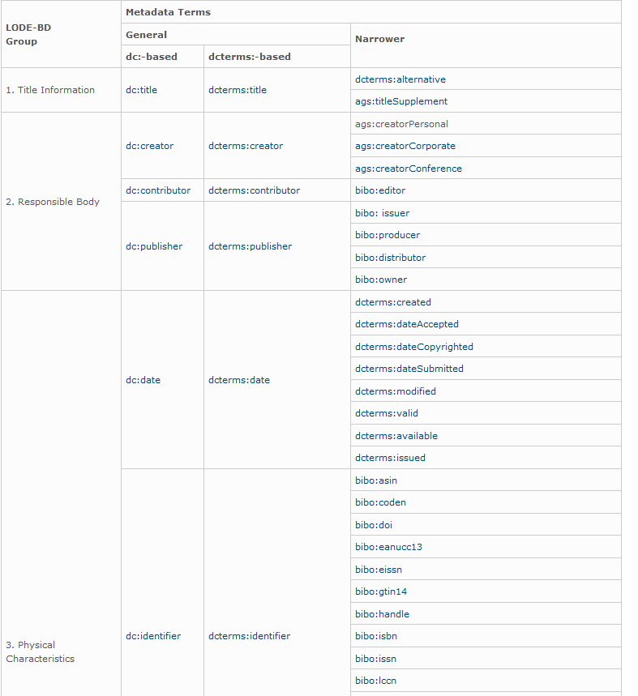
LODE-BD Groups
9 Chunks of Properties
1. Title Information
2. Responsible Body
3. Physical Characteristics
4. Location
5. Subject
6. Description of content
7. Intellectual property
8. Usage
9. Relation between documents / agents
http://aims.fao.org/fr/metadata/m2b
Notes:
LODE-BD has built its recommendations on 9 groups of common properties for describing bibliographic resources (details explained in M2B). These include specific best practice recommendations for about two-dozen properties used for describing a bibliographic resource as well as an additional two sets of properties for describing relations between bibliographic resources or between agents.
#9 Relation. This group has a different perspective for describing the resources from other groups that focus on describing the resource itself. Here, various relations between two resources or between two agents are the focus of description.
See more explanations at M2B website.
http://aims.fao.org/advice/metadata-beta-version

Slide 10
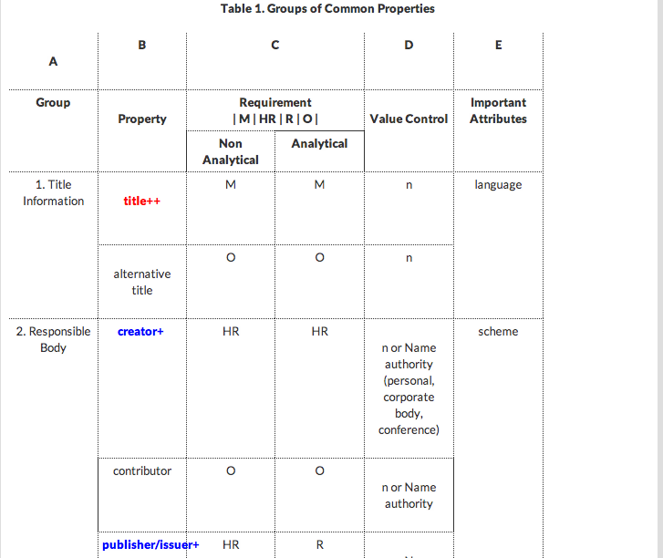
Minimum properties
“++” = mandatory property
“+" = highly recommended
LODE-BD Groups
LODE－BD九大组属性和关系
1. Title Information
2. Responsible Body
3. Physical Characteristics
4. Location
5. Subject
6. Description of content
7. Intellectual property
8. Usage
9. Relation between documents / agents
http://aims.fao.org/fr/metadata/m2b
http://aims.fao.org/advice/metadata-beta-version
Notes:
For the 9 chunks LODE-BD also indicated mandatory and highly recommended properties for describing bibliographic resources. In the center is about what to do with the resources that are described as a whole, like a proceedings, or with the resources that are described at analytical level, e.g., every paper in the proceedings.

Slide 11
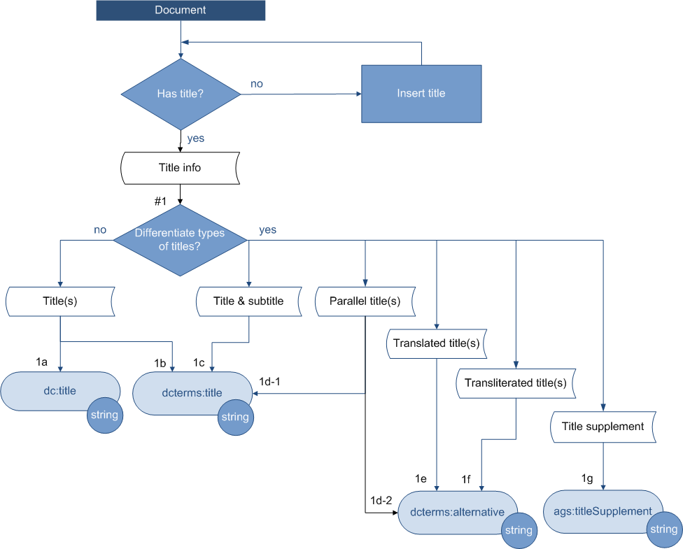
Step 3. Walk through the LODE-BD decision trees,
one by one
Notes:
To assist in the metadata term selection, LODE-BD provides decision trees for the properties included in each of the nine chunks.
Starting from the property that describes a resource instance, each flowchart presents decision points and gives a step-by-step solution to a given problem of metadata encoding.
A data provider can highlight the decision path and mark the metadata terms to be used at the end.
Here we start with a title of a resource. If you want to differentiate different types of title, you will ended up at the right side.

Slide 12
Step 3. Walk through the LODE-BD decision trees,
one by one
Notes:
At the end of a tree branch there is a number indicating the decision. There is a table interpreting the decision tree, with examples.
Let's take a look.

Slide 13
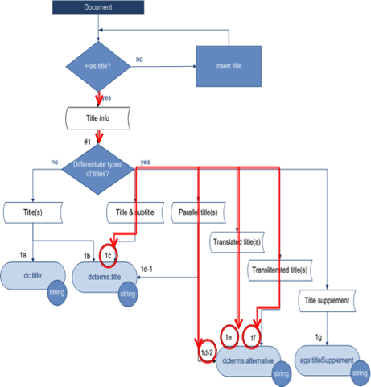
Step 4. Find metadata terms & the encoding examples
Notes:
For each decision tree there is a text-based explanations corresponding to each of the flowcharts, with notes, steps, and examples, are also provided.
Take a look at the title information decision, 1c, you will see that metadata terms dcterms:title is recommended, and an example is provided.

Slide 14
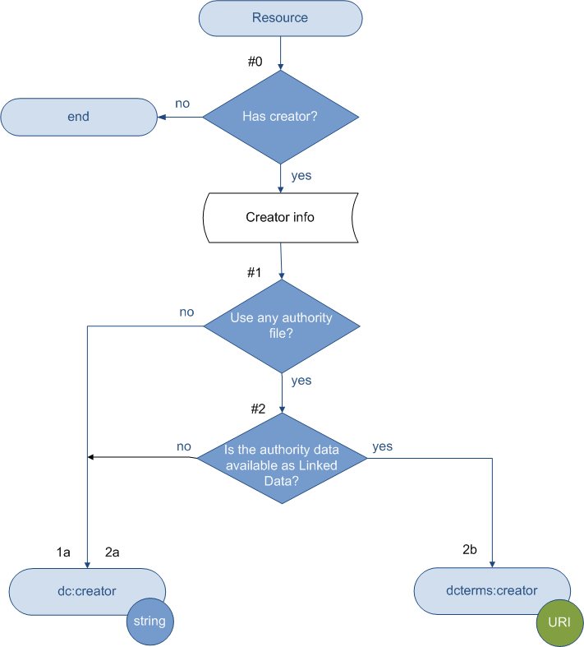
Follow the path to find a direct road to the LOD
Notes:
Here is the flowchart for creator information. The first question is if one has used an authority file. The second question is if that authority data is available as Linked Data, like VIAF, the Virtual International Authority File. If not, the end node is a blue circle, string. If the name authority is in Linked Data, the end node is a green circle, marked as URI.
It is important to note the ending value type:
literals (typically a string of characters; indicated by “string” in the flowcharts), or
non-literals (a value which is a physical, digital or conceptual entity; indicated by “URI” in the flowcharts), depending on the requirements expressed in the namespace.
DCMI Abstract Model. http://www.dublincore.org/documents/abstract-model/ Last accessed June 2012
You may also noticed that on the left, the metadata term has a prefix dc. On the right side, the prefix is dcterms. Both are for creator, but the prefixes are different. Why?

Slide 15
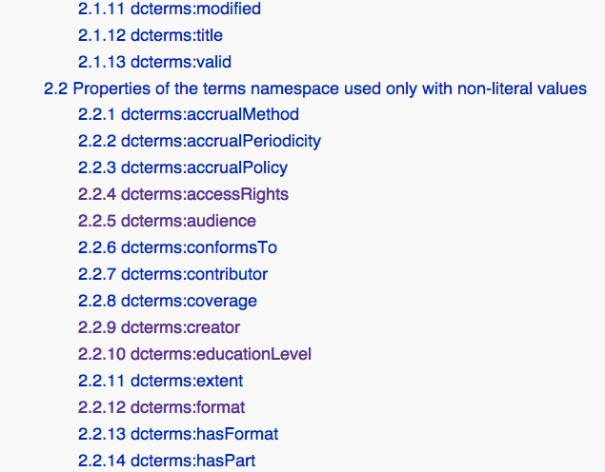
DC Terms User Guide/Publishing Metadata
These properties can only use non-literal values
http://wiki.dublincore.org/index.php/User_Guide/Publishing_Metadata
Notes:
In the dc prefix, the elements came from the Dublin Core legacy or classical namespace. No constraint is defined for the elements.
But in the later developed DCMI Metadata Terms, each property has been assigned certain constraints, such as the domain or range.
Therefore some terms can be used only with non-literal values, such as creator.
For more details you can go to the website to find details.
We know that it is confusion. People would ask should we use dc:creator or dcterms:creator? When I can use literal? That is why we made those flowchart, so we already interpreted what value you can use in the flowchart.

Slide 16
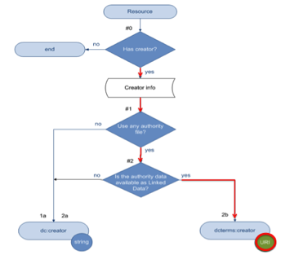
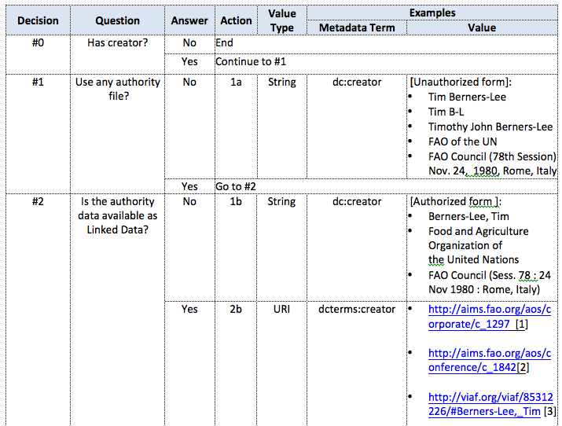
See next slide for a larger image
Notes:
Let's go into the text explanation again.
From that decision tree, we had two different kinds of values, string and URI. From examples we can see what these mean. Next page has a larger layout.

Slide 17
Notes:
Look at #1 decision…
#2…

Slide 18
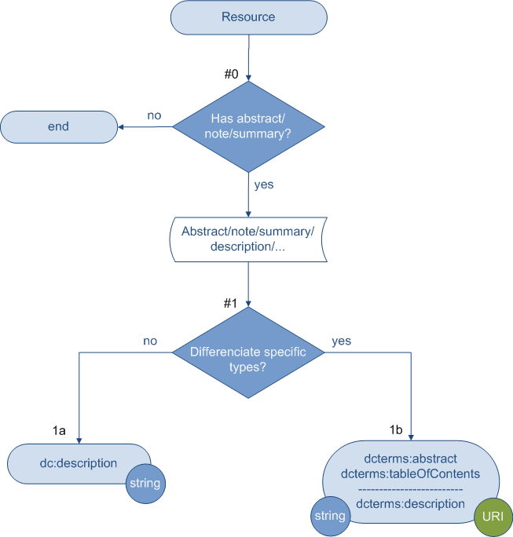
Notes:
Sometimes, there are options for what metadata term to use and what kinds of value to use. For example, at the end on right, we can use either just text strings for the abstract or table of content, or use a URI if that piece is a resource itself and has its URI.

Slide 19
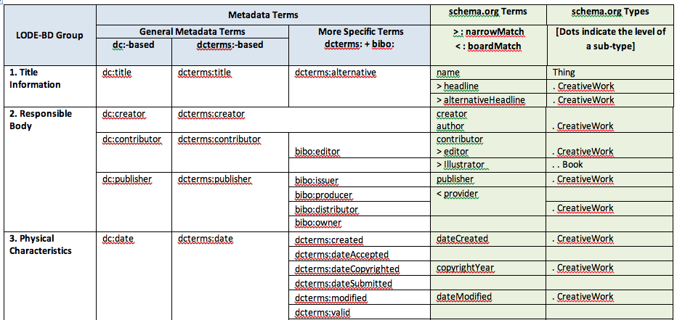
A list of all metadata terms used in LODE-BD and a crosswalk to Schema.org terms
http://aims.fao.org/lode/bd-2/schema-org-crosswalk
Notes:
LODE-BD provided a crosswalk of all metadata terms suggested. The grey part is Dublin-core based terms. In addition to general level we also provided detailed terms. For example, for Responsible body, the general terms are just creator, contributor, publisher, the more specific terms have editor, issuer, producer, etc. Those are based on the data dictionaries we collected. We keep the details because some repositories have the detailed data fields.
Since Schema.org came out, we made a crosswalk to the properties in schema.org. So, if Web masters wants to embed those properties in their webpage markup, they can directly use this table to do the markup. By this way their webpages will have more semantically meaningful markup and search engines can understand them.

Slide 20
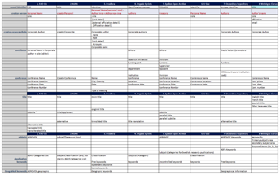
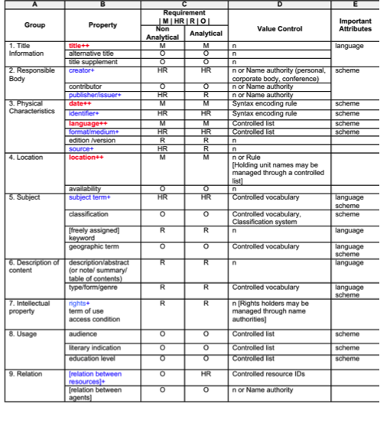
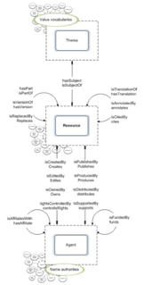
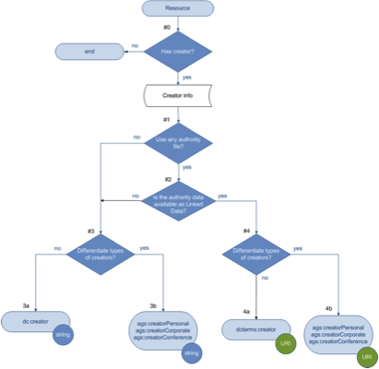
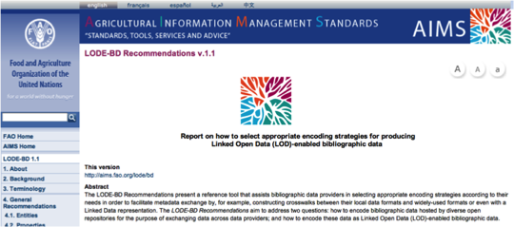
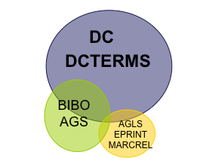
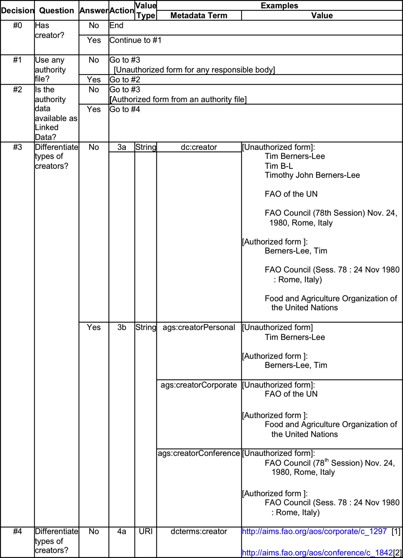
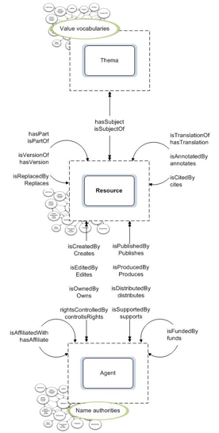
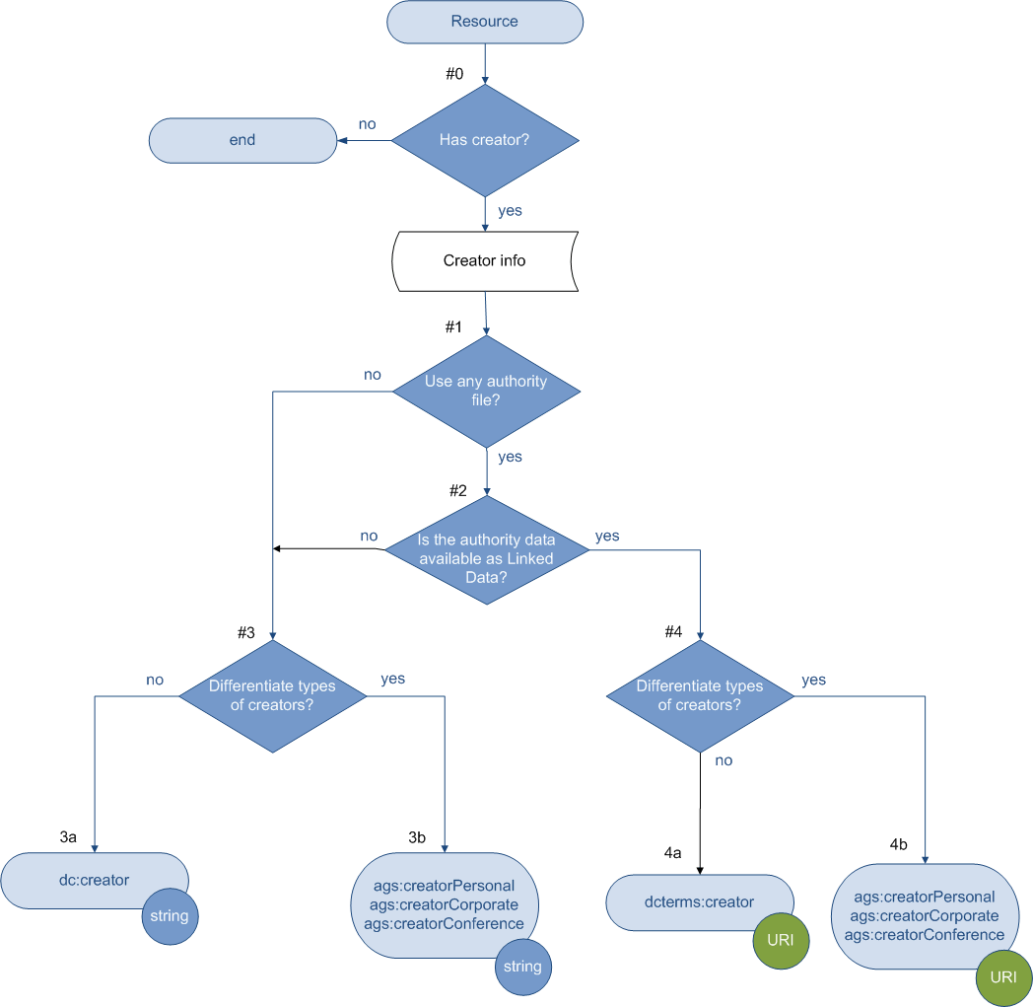
Summary：LODE－BD Method
Various Data Dictionaries & Sample Records
9 Chunks of Properties
18 Decision Trees &
Scenarios
LODE-BD
DC
DCTERMS
BIBO AGS
AGLS EPRINT
MARCREL
Notes:
In summary, here was what LODE-BD has done:

Slide 21
Step 5. Implement the LODE-BD approach in a system
Alternative #1, "Design-time" strategy: go back and change your current ad-hoc model to use the LODE “good practices” model. = > This means some changes to your database and the services that access it.
Alternative #2, "Run-time" strategy: you convert on the fly to a “good-practices” model upon request and leave your ad-hoc model unchanged. => This means adding a conversion service.
Notes:
After metadata terms are selected based on the flowcharts provided in the previous sections, a data provider should have come up with a list of the metadata terms that are appropriate for its existing bibliographic data. To implement these metadata terms, LODE-BD shares two options that have been summarized based on the best practices.
Option #1, "Design-time" strategy: The data provider would need to change its current ad-hoc model, replacing it with the LODE-BD “good practices” model and those selected metadata terms. This means some changes to a database and the services that access it.
Option #2, "Run-time" strategy: The data provider would keep the original ad-hoc model and database structure. A data provider would convert bibliographic data on the fly to a “good-practices” model upon request. This means to add a conversion service and leave the ad-hoc model unchanged.
Image credit: #1, painting. Change Meditation. http://www.anvention.com/?q=changemeditation
Image credit #2, Communication. http://vudat.msu.edu/teach/using-communication

Slide 22
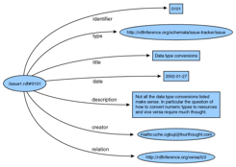
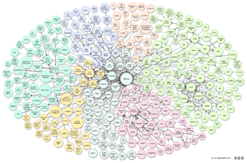
Step 6. Output your data
search & browse
records
My data
Metadata
Repository
RDF graphs
LOD
Notes:
Turning the bibliographic data from an ad-hoc modeled database in a silo to the data in a standardized metadata repository, it is a giant leap because the unified data records from various data providers can be maximized in searching and browsing through the services of the repository. Furthermore, the same practice could also lead to a step heading to the LOD universe.
The individual data providers can directly produce RDF triples using LODE-BD recommended metadata terms. Or, this mission can be accomplished through the metadata repository, which would publish its bibliographic data as Linked Data, as illustrated in the following figure. In both outcomes, preparing LOD-ready metadata by data providers is essential.

Slide 23
LODE-BD principles
To promote the use of well-established metadata standards and the emerging LOD-enabled vocabularies proposed in the Linked Data community;
To encourage the use of authority data, controlled vocabularies, and syntax encoding standards in metadata statements whenever possible;
To encourage the use of resource URIs as data values when they are available;
To facilitate the decision-making process regarding data encoding for the purpose of exchange and reuse;
To provide a reference support that is open for suggestions of new properties and metadata terms according to the needs of the Linked Data community.
Notes:
As you can tell, LODE-BD was developed based on these principles:
Promote the use of well-established metadata standards
to encourage the use of authority data, controlled vocabularies, syntax encoding standards,
to encourage the use of resource URIs as data values when they are available,
we want decision making regarding data encoding think about exchange and reuse
and we also make this open for new properties and terms.

Slide 24
Thank You!
LODE-BD Recommendations v.2.0
http://aims.fao.org/lode/bd
See also: AGROVOC as LOD, http://aims.fao.org/standards/agrovoc/about
OpenAgris bibliographic data as LOD. http://aims.fao.org/openagris
Notes:
You can find the Recommendations online at FAO website. There are also lists of references regarding publishing and consuming Linked Data.
In practice you can also consult the Linked Data version of AGROVOC, the thesaurus of FAO, and its mapping to many other concept schemes.
The OpenAGRIS that made whole bibliographic data as Linked Data and mash up on the fly is also very creative and exciting.

